Slide 1
GRAMMAR IMPROVEMENT MINI LESSONS
1
2
3
4
5
6
Fragment
Run-on sentence
Comma conjunction
Comma after introductory clause
Comma around interrupters
Commas in a list
7
8
9
10
11
12
Comma splices
Semicolon use
Colon and dashes
Possessive vs plural nouns
Personal pronouns
Ambiguous pronoun reference
13
14
15
16
17
18
Misplaced modifiers
Subject verb agreement
Verb tense shift
Irregular verbs
MLA Formatting
Misc. Error
Style Lessons

Slide 2
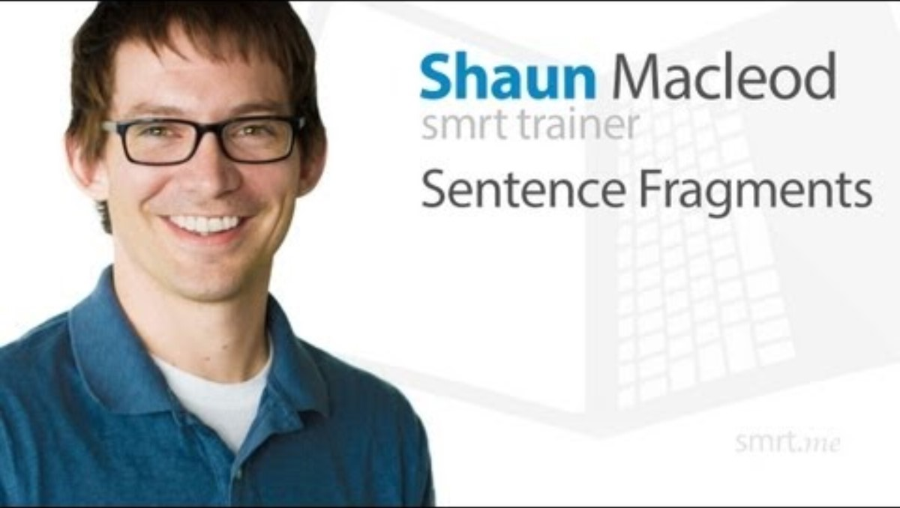
1
Fragment
Embed YouTube video here by going to insert> media> video > online video and copy and paste the link below (I can’t do this for you). You could also just delete this box and have the link. If your school blocks YouTube, you can simply take all this out and just rely on the written mini lesson and mentor sentences. Or, you could download the YouTube video and insert from your device.
A complete sentence contains a subject (something performing action), a verb (the action being performed), and expresses a complete thought. A sentence fragment occurs when one of these is missing.
Lacks subject: Sitting on the shelf.
Revision: The books are sitting on the shelf
Lacks verb: Books on the shelf.
Revision: Ashley put the books on the shelf.
Lacks complete thought: When the books are on the shelf.
Revision: When the books are on the shelf, the room looks tidier.
https://www.youtube.com/watch?v=r-Wcr4Wgf7U
More Practice:
Complete the quiz here for more practice.
Explore further here: https://writingcenter.unc.edu/tips-and-tools/fragments-and-run-ons/
Grammar Lessons
Style Lessons

Slide 3
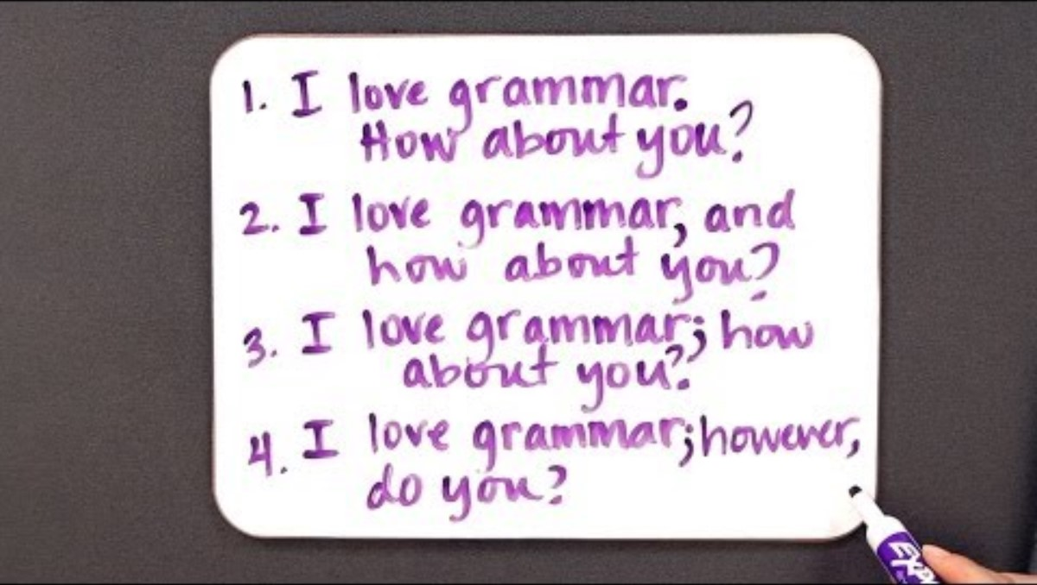
2
Run-on sentence
Embed YouTube video here by going to insert> media> video > online video and copy and paste the link below (I can’t do this for you). You could also just delete this box and have the link. If your school blocks YouTube, you can simply take all this out and just rely on the written mini lesson and mentor sentences. Or, you could download the YouTube video and insert from your device.
Avoid run-on sentences by combining two independent clauses using a comma conjunction (For, And, Nor, But, Or, Yet, So…FANBOYS) or a semicolon. Or, correct a run-on by dividing the independent clauses into two separate sentences.
Lacks semicolon: I want to finish the book, I don’t want to be late for school
Revision: I want to finish the book; however, I don’t want to be late for school.
Lacks comma FANBOY: I want to finish the book I don’t want to be late for school.
Revision: I want to finish the book, but I don’t want to be late for school.
Lacks new sentence: I want to finish the book I don’t want to be late for school
Revision: I want to finish the book. But, I don’t want to be late for school.
https://www.youtube.com/watch?v=yk2ObCorLUk
More Practice:
Complete the quiz here for more practice.
Explore further here: https://academicguides.waldenu.edu/writingcenter/grammar/runonsentences
Grammar Lessons
Style Lessons

Slide 4
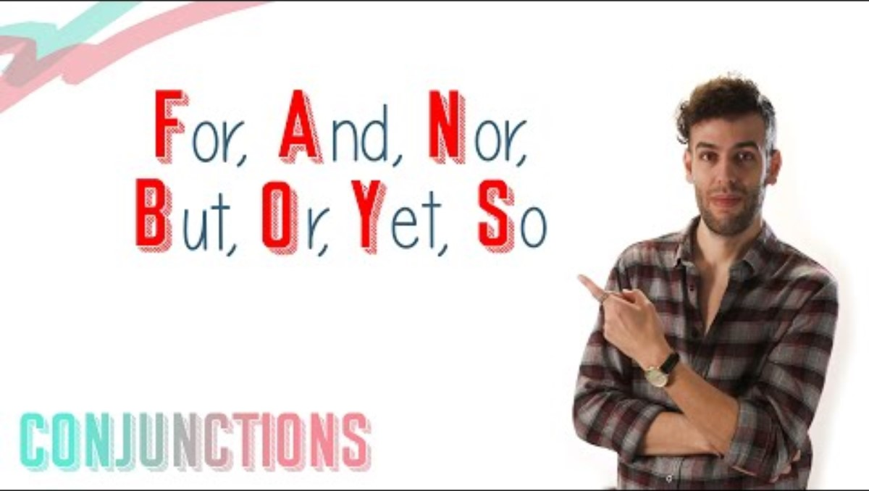
3
Comma conjunction
Embed YouTube video here by going to insert> media> video > online video and copy and paste the link below (I can’t do this for you). You could also just delete this box and have the link. If your school blocks YouTube, you can simply take all this out and just rely on the written mini lesson and mentor sentences. Or, you could download the YouTube video and insert from your device.
Conjunctions (FANBOYS) are often, but not always, preceded by a comma. It’s tempting to add a comma every time a conjunction appears, but it’s not always correct. Only add a comma before a conjunction if the comma/conjunction pair is separating two independent clauses. Make sure the clause on either side of the comma/conjunction could be its own sentence. If not, then a comma is not necessary.
Lacks two independent clauses: He went to the bookstore, and bought a book.
Revision: He went to the bookstore and bought a book.
https://www.youtube.com/watch?v=tk9DrpOPLCY
More Practice:
Click here for more practice.
Explore further here: https://owl.purdue.edu/owl_exercises/punctuation_exercises/commas/index.html
Grammar Lessons
Style Lessons

Slide 5
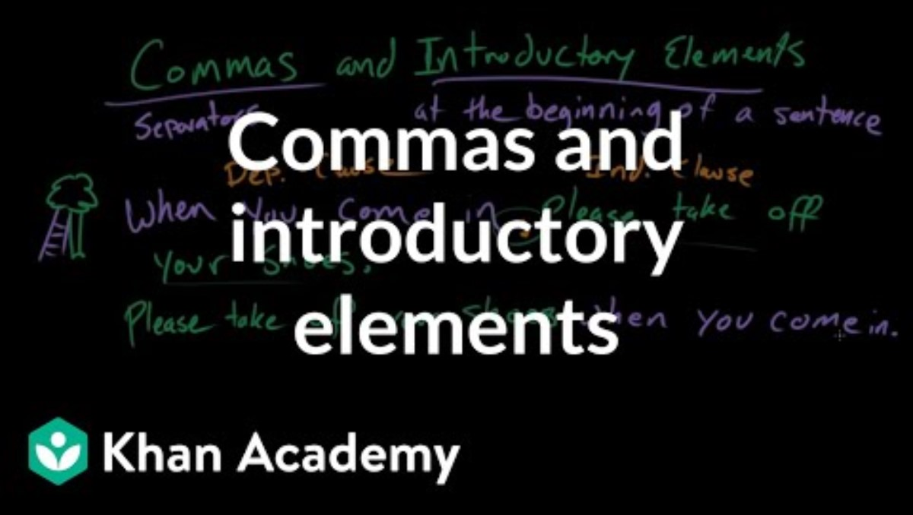
4
Comma after introductory clause
Embed YouTube video here by going to insert> media> video > online video and copy and paste the link below (I can’t do this for you). You could also just delete this box and have the link. If your school blocks YouTube, you can simply take all this out and just rely on the written mini lesson and mentor sentences. Or, you could download the YouTube video and insert from your device.
Independent clauses (containing a subject and a predicate) are sometimes preceded by introductory words (transitions & names) or introductory clauses (dependent clauses). Introductory words and clauses need to be followed by commas.
Lacks comma: Furthermore I hope she decides to write another book.
Revision: Furthermore, I hope she decides to write another book.
Extra comma: Before, you buy that book, visit your local library.
Revision: Before you buy that book, visit your local library.
https://www.youtube.com/watch?v=NvGBug8iORE
More Practice:
Click here for more practice.
Explore further here: https://owl.purdue.edu/owl/general_writing/punctuation/commas/commas_after_introductions.html
Grammar Lessons
Style Lessons

Slide 6
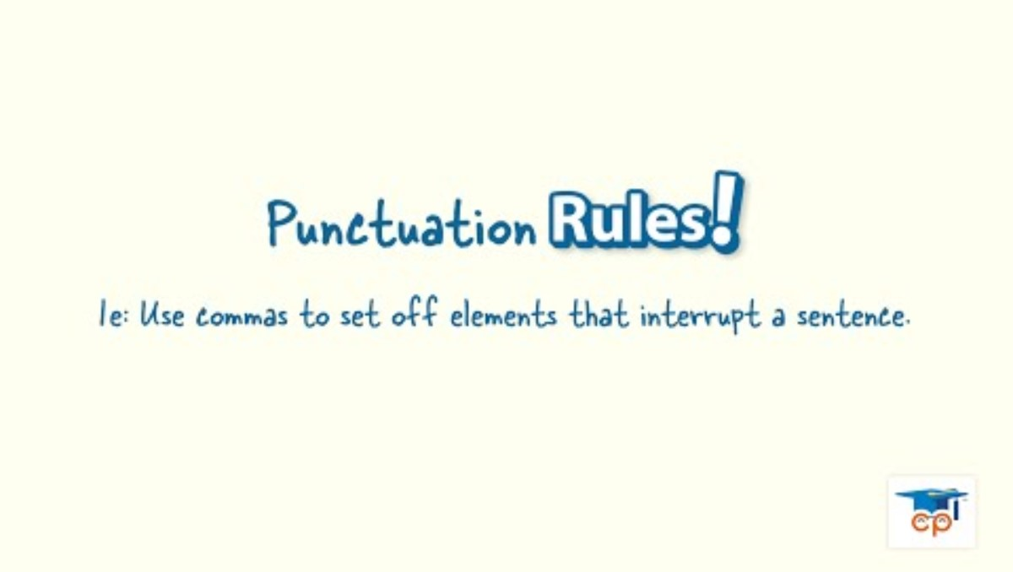
5
Comma around interrupters
Embed YouTube video here by going to insert> media> video > online video and copy and paste the link below (I can’t do this for you). You could also just delete this box and have the link. If your school blocks YouTube, you can simply take all this out and just rely on the written mini lesson and mentor sentences. Or, you could download the YouTube video and insert from your device.
Appositive phrases, or “interrupters,” provide more information about the subject of a sentence. These phrases are not necessary for the grammatical correctness of the sentence and can be removed without error. They are set aside with commas.
Appositive at the start of a sentence:
A renowned writer, Toni Morrison paved the way for a new generation of authors.
Appositive in the middle of the sentence:
Toni Morrison, an award winning writer, is responsible for many canonical texts.
https://www.youtube.com/watch?v=E7TKMaFMzSQ
More Practice:
Click here for more practice.
Explore further here: https://owl.purdue.edu/owl/general_writing/grammar/appositives.html
Grammar Lessons
Style Lessons

Slide 7

6
Commas in a list
Embed YouTube video here by going to insert> media> video > online video and copy and paste the link below (I can’t do this for you). You could also just delete this box and have the link. If your school blocks YouTube, you can simply take all this out and just rely on the written mini lesson and mentor sentences. Or, you could download the YouTube video and insert from your device.
The Oxford comma is the final comma in a list or series of three or more things. When creating lists in sentences, be sure to structure the sentence with parallelism and set off each item in the list with commas. The final item in the list will be preceded by a comma followed by “and.”
Lacks Oxford comma: The girl enjoyed reading books about princesses, dragons and knights.
Revision: The girl enjoyed reading books about princesses, dragons, and knights.
https://www.youtube.com/watch?v=qx55pQjoLk4
More Practice:
Click here for more practice.
Explore further here: https://study.com/academy/practice/quiz-worksheet-the-oxford-comma.html
Grammar Lessons
Style Lessons

Slide 8
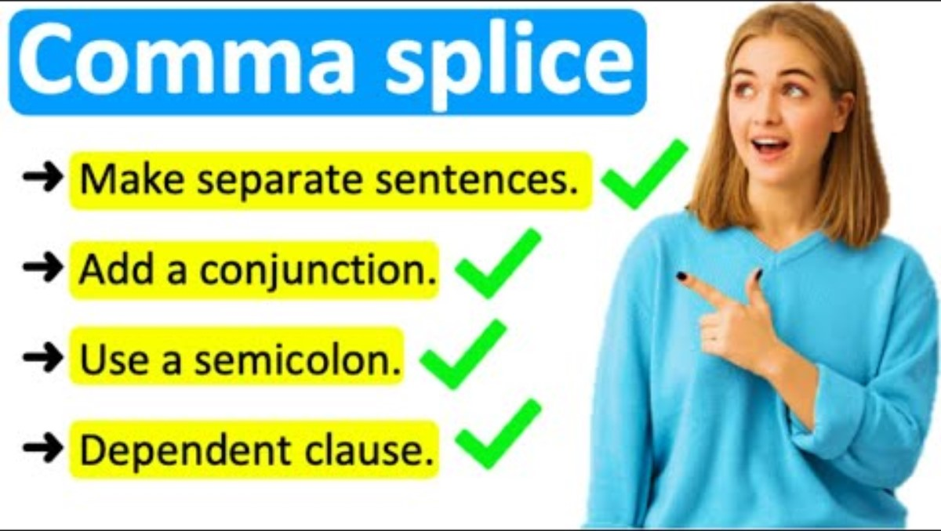
7
Comma splices
Embed YouTube video here by going to insert> media> video > online video and copy and paste the link below (I can’t do this for you). You could also just delete this box and have the link. If your school blocks YouTube, you can simply take all this out and just rely on the written mini lesson and mentor sentences. Or, you could download the YouTube video and insert from your device.
A comma splice occurs when you join two independent clauses with only a comma. To fix this, you can follow the comma with a conjunction (FANBOYS), use a semicolon, or separate the clauses into two sentences.
Unnecessary comma: Reading is fun, and cool.
Revision: Reading is fun and cool.
Lacks conjunction: I love this book, you should read it.
Revision: I love this book, so you should read it.
Lacks semicolon: I saw the movie, the book is better.
Revision: I saw the movie; the book is better.
https://www.youtube.com/watch?v=Q9RfrOTqlp8
More Practice:
Click here for more practice.
Explore further here: https://advice.writing.utoronto.ca/revising/comma-splices/
Grammar Lessons
Style Lessons

Slide 9
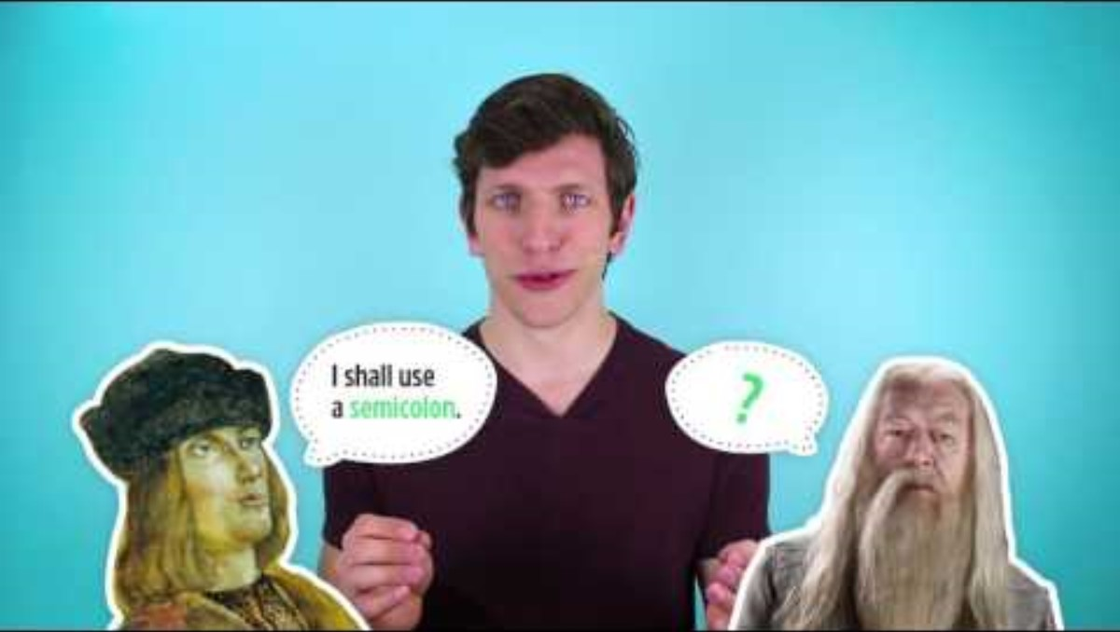
8
Semicolon use
Embed YouTube video here by going to insert> media> video > online video and copy and paste the link below (I can’t do this for you). You could also just delete this box and have the link. If your school blocks YouTube, you can simply take all this out and just rely on the written mini lesson and mentor sentences. Or, you could download the YouTube video and insert from your device.
Use a semicolon to combine two independent clauses without a conjunction. But, only combine clauses discussing related information. Be intentional with your semicolon usage!
Unnecessary conjunction: I didn’t like that book; and it really scared me.
Revision: I didn’t like that book; it really scared me.
Unnecessary conjunction: She was devastated that she forgot her bookmark; because she hated to dog-ear the pages.
Revision: She was devastated that she forgot her bookmark; she hated to dog-ear the pages.
https://www.youtube.com/watch?v=o-f2riEA4mY
More Practice:
Click here for more practice.
Explore further here: https://owl.purdue.edu/owl_exercises/punctuation_exercises/commas/commas_vs_semicolons_compound_sentences.html
Grammar Lessons
Style Lessons

Slide 10

9
Colons and dashes
Embed YouTube video here by going to insert> media> video > online video and copy and paste the link below (I can’t do this for you). You could also just delete this box and have the link. If your school blocks YouTube, you can simply take all this out and just rely on the written mini lesson and mentor sentences. Or, you could download the YouTube video and insert from your device.
Colons are usually used to add clarifying information to a sentence. Colons usually come before lists, quotes, or definitions.
On the other hand, dashes are usually used to emphasize a point by setting it apart from other information. Dashes are a more dramatic version of a comma.
Colon: You can find the answer in these places: books, libraries, or databases.
Colon: Shakespeare once said: "To thine own self be true."
Dash: If I could give you one piece of advice, it would be this— read more.
Dash: This simple act— reading more— improved my life significantly.
https://www.youtube.com/watch?v=uHpmmINFq_g
More Practice:
Click here for more practice.
Explore further here: https://www.khanacademy.org/humanities/grammar/punctuation-the-colon-semicolon-and-more
Grammar Lessons
Style Lessons

Slide 11
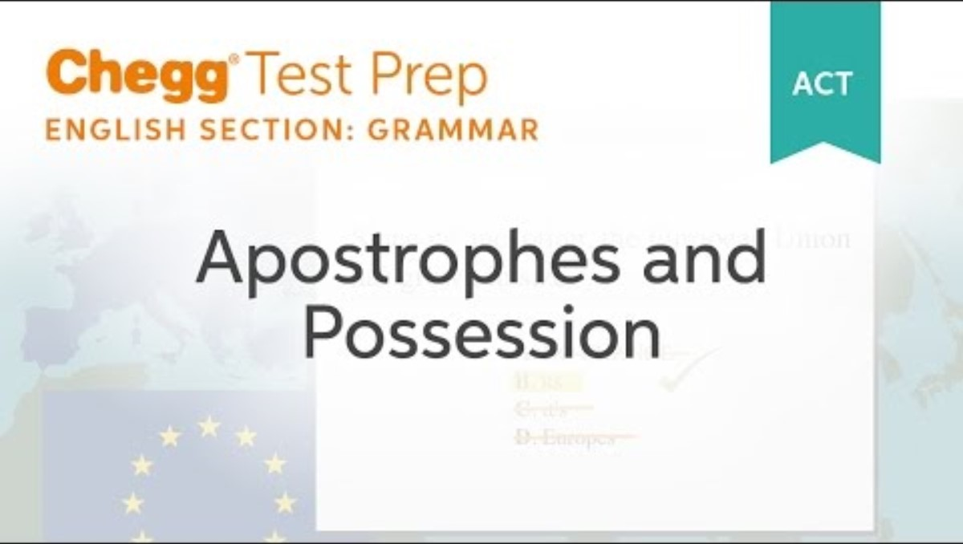
10
Possessive vs plural nouns
Embed YouTube video here by going to insert> media> video > online video and copy and paste the link below (I can’t do this for you). You could also just delete this box and have the link. If your school blocks YouTube, you can simply take all this out and just rely on the written mini lesson and mentor sentences. Or, you could download the YouTube video and insert from your device.
Possessive nouns include an apostrophe + -s to show ownership. Nouns become plural when you add an -s to the end (or -es if the noun ends in -s, -sh, -ch, -z, or -x).
Examples:
*The students enjoy reading. (There are multiple students; no ownership is being expressed)
*The student’s books are heavy. (All the books belong to a single student)
*The students’ teacher assigned a new novel unit. (The teacher belongs to multiple students)
*People’s books are important to them. (books belong to more than one person, but “people” is a plural noun that does not end in -s, so add -’s)
https://www.youtube.com/watch?v=ElkPj1g2VBI
More Practice:
Click here for more practice.
Explore further here: https://www.grammarbook.com/punctuation/apostro.asp
Grammar Lessons
Style Lessons

Slide 12
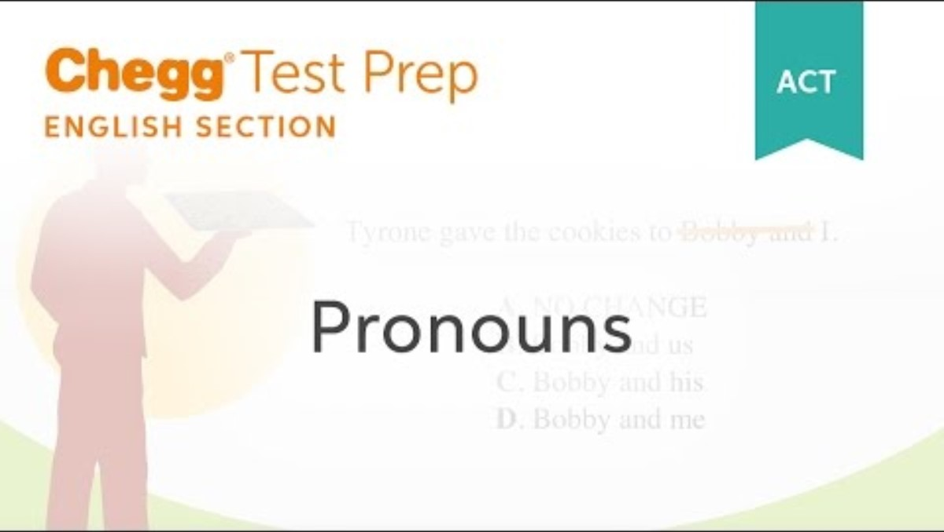
11
Personal pronouns
Embed YouTube video here by going to insert> media> video > online video and copy and paste the link below (I can’t do this for you). You could also just delete this box and have the link. If your school blocks YouTube, you can simply take all this out and just rely on the written mini lesson and mentor sentences. Or, you could download the YouTube video and insert from your device.
Depending on the type of writing, students are often asked to avoid using personal pronouns in formal writing. Here are some ways to avoid using personal pronouns:
Avoid: In this essay, I’m going to tell you about the most influential books in society.
Revision: Books have the ability to change the world and influence society.
Avoid: In my opinion, books should not be banned in high schools.
Revision: To avoid biased censorship, books should not be banned in high schools.
However, if you do use personal pronouns, be sure to format them correctly.
https://www.youtube.com/watch?v=rYdo7ZxynWk
More Practice:
Click here for more practice.
Explore further here: https://www.grammarly.com/blog/the-basics-on-subject-and-object-pronouns-b/
Grammar Lessons
Style Lessons

Slide 13
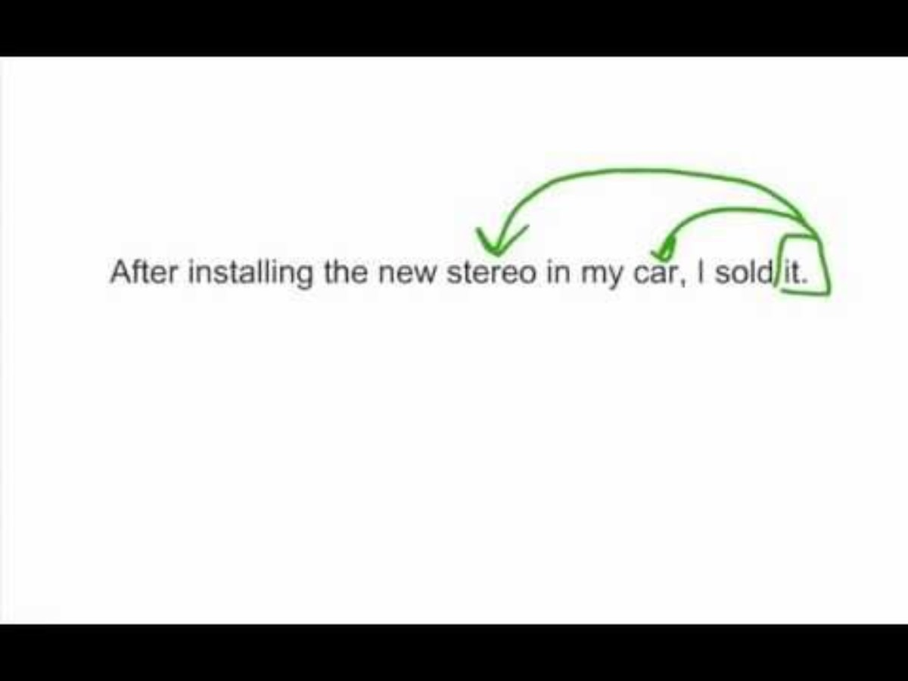
12
Ambiguous pronoun reference
Embed YouTube video here by going to insert> media> video > online video and copy and paste the link below (I can’t do this for you). You could also just delete this box and have the link. If your school blocks YouTube, you can simply take all this out and just rely on the written mini lesson and mentor sentences. Or, you could download the YouTube video and insert from your device.
Ambiguous, or vague, pronouns do not clearly connect to their antecedents. This occurs when the pronoun could refer to more than one noun in the sentence.
Examples:
Lacks pronoun clarity: The teachers took their classes to the library; they liked chatting with the librarian.
Revision: The teachers took their classes to the library; the teachers enjoyed chatting with the librarian.
https://www.youtube.com/watch?v=rFuswt2-j8A
More Practice:
Click here for more practice.
Explore further here: https://www.swarthmore.edu/writing/pronoun-reference-0
Grammar Lessons
Style Lessons

Slide 14
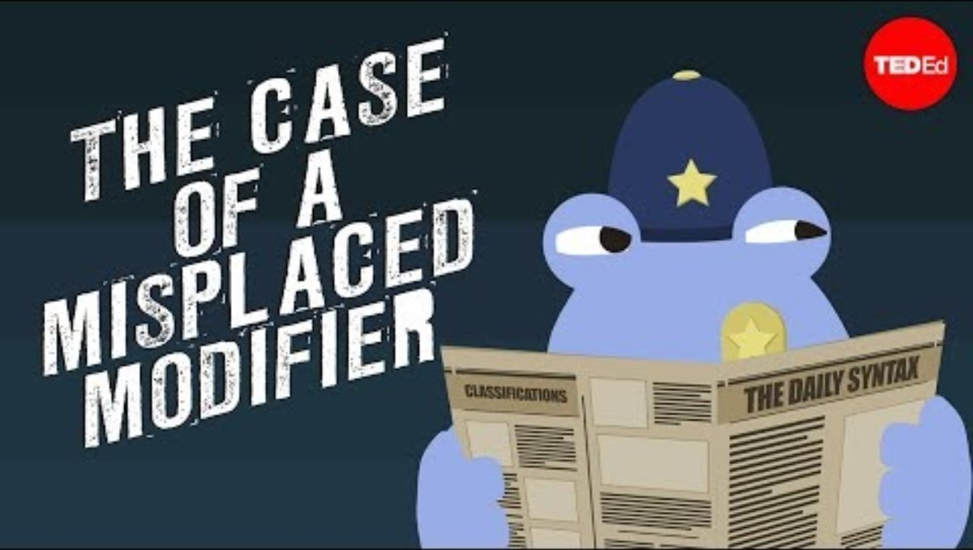
13
Misplaced modifiers
Embed YouTube video here by going to insert> media> video > online video and copy and paste the link below (I can’t do this for you). You could also just delete this box and have the link. If your school blocks YouTube, you can simply take all this out and just rely on the written mini lesson and mentor sentences. Or, you could download the YouTube video and insert from your device.
A modifier is a word or phrase meant to describe another part of a sentence. When modifiers are “misplaced”, it means that they do not clearly describe the intended portion of the sentence. Oftentimes, sentence rearrangement is necessary to fix this.
Examples:
Misplaced modifier: She made history as the first female author to win this award in 1992.
Revision: In 1992, she made history as the first female author to win this award.
https://www.youtube.com/watch?v=-tX34V_XGeQ
More Practice:
Click here for more practice.
Explore further here: https://www.khanacademy.org/humanities/grammar/syntax-conventions-of-standard-english/dangling-modifiers-and-parallel-structure/e/dangling-modifiers
Grammar Lessons
Style Lessons

Slide 15
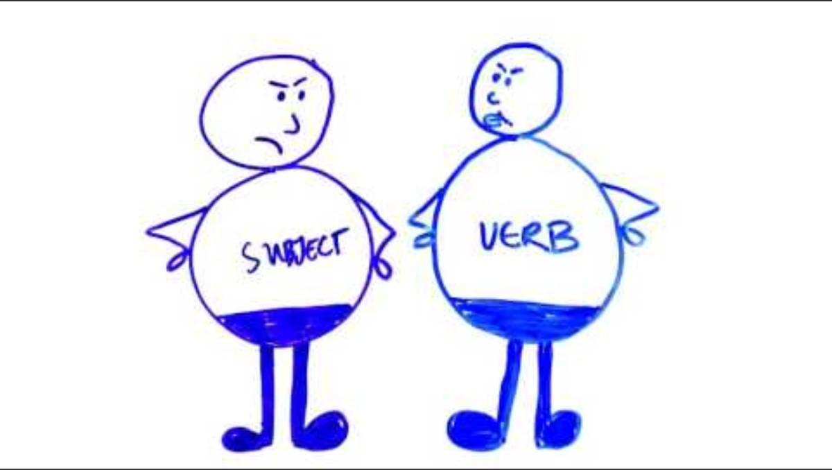
14
Subject-verb agreement
Embed YouTube video here by going to insert> media> video > online video and copy and paste the link below (I can’t do this for you). You could also just delete this box and have the link. If your school blocks YouTube, you can simply take all this out and just rely on the written mini lesson and mentor sentences. Or, you could download the YouTube video and insert from your device.
Subject-verb agreement means the verb form you choose must “agree” with the subject of the sentence. When the subject and verb are placed directly next to one another, deciding on subject-verb agreement is simple. However, when the subject and verb are separated in the sentence, errors in agreement may occur.
Example:
The book tour, taking place across many US cities, arrives at our local library this weekend.
In the sentence above, the verb (“arrives”) must agree with the singular subject (“event”) and not the closest plural noun (“cities”).
https://www.youtube.com/watch?v=cHLhlgq5szg
More Practice:
Click here for more practice.
Explore further here: https://www.grammarbook.com/grammar/subjectVerbAgree.asp
Grammar Lessons
Style Lessons

Slide 16

15
Verb tense shift
Embed YouTube video here by going to insert> media> video > online video and copy and paste the link below (I can’t do this for you). You could also just delete this box and have the link. If your school blocks YouTube, you can simply take all this out and just rely on the written mini lesson and mentor sentences. Or, you could download the YouTube video and insert from your device.
Verb tense must stay consistent unless the shift is necessary for the meaning of the sentence. Make sure the verb tense matches the subject it refers to.
Examples:
Lacks correct verb tense: She finished the book before donated it.
Revision: She finished the book before donating it.
Lacks correct verb tense: I read the book while he driven home.
Revision: I read the book while he drove home.
https://www.youtube.com/watch?v=SsOOL5tBqfc
More Practice:
Click here for more practice.
Explore further here: https://www.iup.edu/writingcenter/writing-resources/grammar/tense-shifting/
Grammar Lessons
Style Lessons

Slide 17
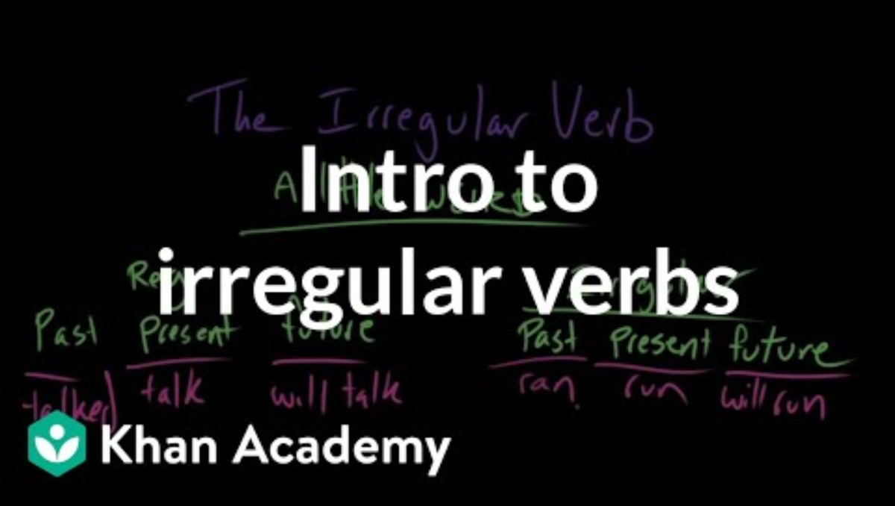
16
Irregular verbs
Embed YouTube video here by going to insert> media> video > online video and copy and paste the link below (I can’t do this for you). You could also just delete this box and have the link. If your school blocks YouTube, you can simply take all this out and just rely on the written mini lesson and mentor sentences. Or, you could download the YouTube video and insert from your device.
Irregular verbs do not follow the typical pattern for present and past forms. Common irregular verbs are: be, begin, choose, do, go, have, lay, say, speak, take, write, and many more
Examples:
I had already begun writing when my pen ran out of ink.
To be seen more, the author needs to do a book tour.
She has chosen a new book to read.
https://www.youtube.com/watch?v=ZKr--3HpP_A
More Practice:
Click here for more practice.
Another option is to leave a link here for students to explore further. Using irregular verbs correctly:
https://www.aresearchguide.com/irregular-verbs.html
Grammar Lessons
Style Lessons

Slide 18
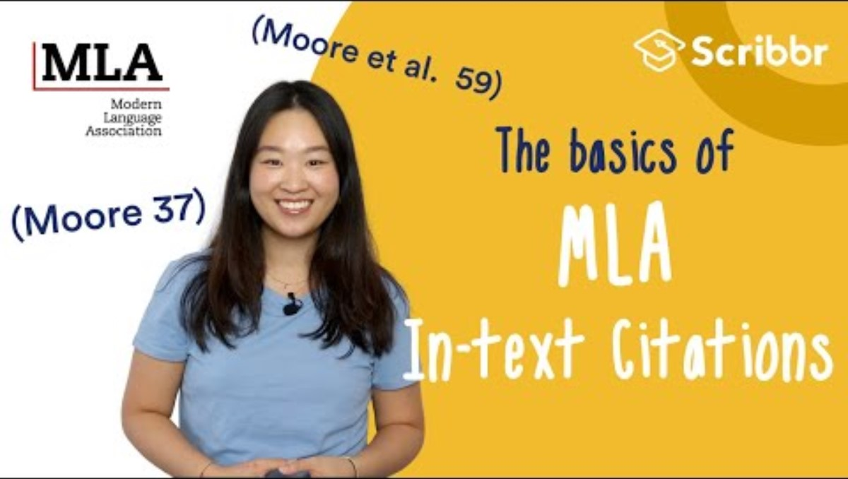
17
MLA formatting
Embed YouTube video here by going to insert> media> video > online video and copy and paste the link below (I can’t do this for you). You could also just delete this box and have the link. If your school blocks YouTube, you can simply take all this out and just rely on the written mini lesson and mentor sentences. Or, you could download the YouTube video and insert from your device.
MLA guidelines are updated often. To have the most current form of MLA citations, check the current guide. You can also use the website Cite This For Me for help. For a quick reference, here are a couple of examples:
“Quote” (Author’s last name page number).
“Quote” (Smith 1).
Paraphrase (Author’s last name page number).
Paraphrase (Smith 1).
https://www.youtube.com/watch?v=ypWxhhpGeyM&t=98s
More Practice:
Click here for more practice.
Explore further here: https://owl.purdue.edu/owl/research_and_citation/mla_style/mla_formatting_and_style_guide/mla_formatting_and_style_guide.html
Grammar Lessons
Style Lessons

Slide 19
18
Misc. errors
More Practice:
It’s important to avoid miscellaneous grammar issues in formal writing. The style in which you text is usually not suitable for formal writing. Pay attention to these informal issues:
Capitalization issue: Always capitalize proper nouns (specific people, places, or things), the first letter of the first word in a sentence, and the pronoun “I”.
Punctuation issue: Add proper punctuation to the end of sentences.
Commonly confused words: Be aware of commonly confused words.
Other grammar issue: If you can’t figure out your miscellaneous issue, ask your teacher for help.
This is where you can copy and paste the quiz associated with this grammar issues if you wish. You must make a copy of the quiz and add it to your own drive before pasting it here. This will ensure that student answers come back to you.
Another option is to leave a link here for students to explore further.
Commonly confused words:
http://writing2.richmond.edu/writing/wweb/conford.html
Capitalization Rules:
https://www.grammarbook.com/punctuation/capital.asp
Grammar Lessons
Style Lessons

Slide 20
STYLE IMPROVEMENT MINI LESSONS
19
20
21
22
23
24
Hook needs focus or flair
Thesis needs focus or flair
Topic sentence needs focus or flair
Concluding sentence needs focus or flair
Transitions need clarity or variety
Conclusion needs variety or flair
25
26
27
28
29
30
Points or details are irrelevant or invalid
Elaboration or connection needed
Support of claim needed
Source needs reevaluated for validity
Embedded quote needs elevated or corrected
Vocabulary needs to be vivid or varied
31
32
33
34
35
36
Sentence variety needed
Passive voice consideration
Parallel structure consideration
Wordiness or unclear cohesion
Tone consideration
Plagiarism issues
Grammar Lessons

Slide 21
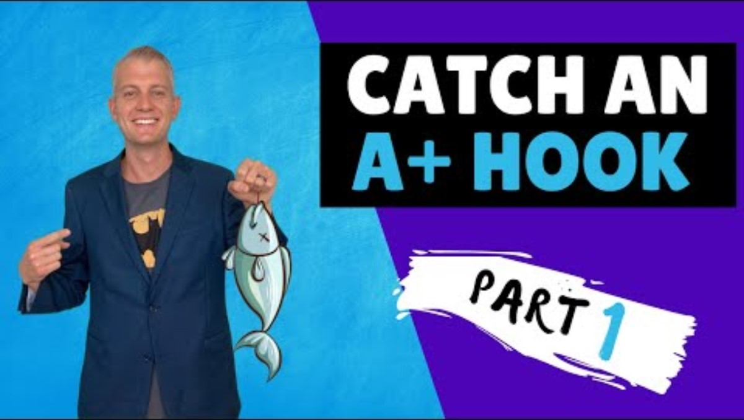
19
Hook needs focus or flair
Embed YouTube video here by going to insert> media> video > online video and copy and paste the link below (I can’t do this for you). You could also just delete this box and have the link. If your school blocks YouTube, you can simply take all this out and just rely on the written mini lesson and mentor sentences. Or, you could download the YouTube video and insert from your device.
The term “hook” is often used to refer to the opening sentence(s) of an essay. It should be engaging, relevant, and captivating. Here are some hook ideas:
Make a strong statement or declaration
Offer a shocking fact or statistic
Refute a common belief
Tell a personal story related to the topic
Contrast idealism with reality
Use imagery to paint a picture
Add appropriate humor or wit
Present a clever analogy
Stir up conflict with loaded words
Give a warning related to the topic
Tap into human emotions
https://www.youtube.com/watch?v=yvrnVHd-oyM
More Practice:
Explore further here: https://www.academicwritingsuccess.com/7-sensational-essay-hooks/
Grammar Lessons
Style Lessons

Slide 22
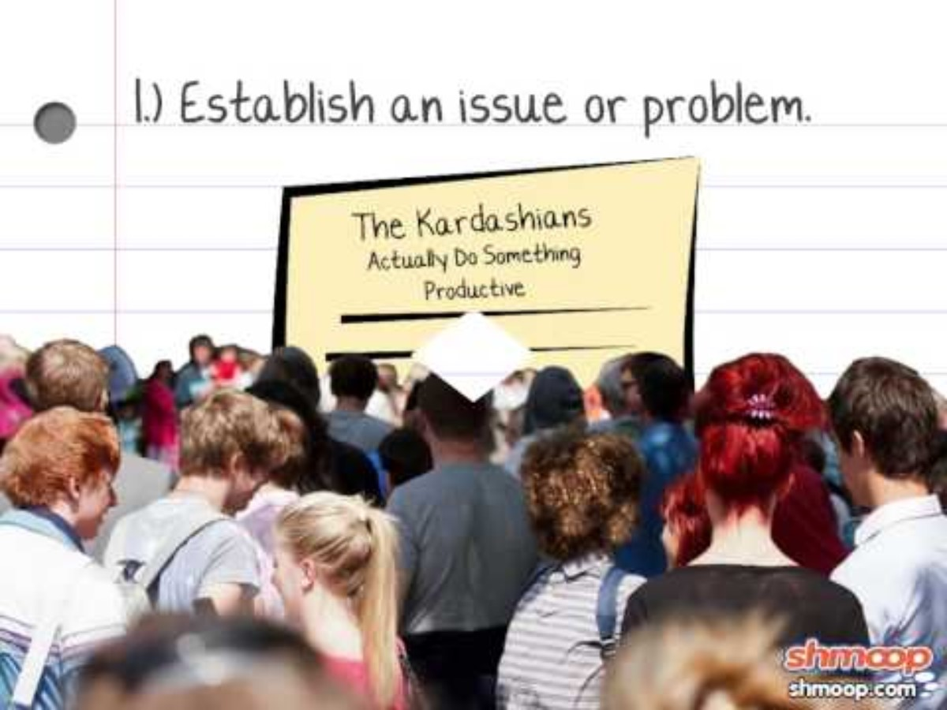
20
Thesis needs focus or flair
Embed YouTube video here by going to insert> media> video > online video and copy and paste the link below (I can’t do this for you). You could also just delete this box and have the link. If your school blocks YouTube, you can simply take all this out and just rely on the written mini lesson and mentor sentences. Or, you could download the YouTube video and insert from your device.
Thesis statements tell the reader the significance of the subject and the writer’s thoughts or stance on the topic. The thesis acts as a guide to how the writer will support those thoughts or that stance. A thesis is an interpretation of a subject or the answer to a question — not a question itself. To be valid, the thesis must provide an arguable claim rather than an accepted truth. To summarize, a thesis answers a question, can be proven, and leads to discussion.
Thesis checklist:
Does your thesis answer the prompt?
Can someone argue a different side?
Will your thesis guide your essay?
https://www.youtube.com/watch?v=8wxE8R_x5I0
More Practice:
You can find some sample thesis statements here: https://www.easybib.com/guides/how-to-write-a-strong-thesis-statement/
Grammar Lessons
Style Lessons

Slide 23
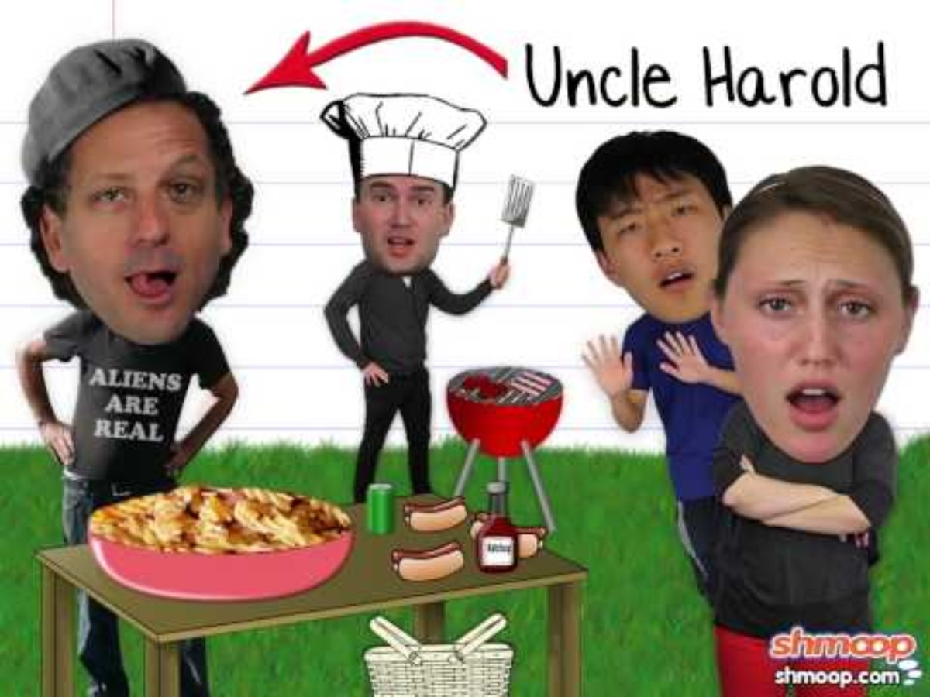
21
Topic sentence needs focus or flair
Embed YouTube video here by going to insert> media> video > online video and copy and paste the link below (I can’t do this for you). You could also just delete this box and have the link. If your school blocks YouTube, you can simply take all this out and just rely on the written mini lesson and mentor sentences. Or, you could download the YouTube video and insert from your device.
Once the thesis takes shape, the rest of the writing will work to support and relate back to ideas presented in its stance.
Since the thesis is the guide for the essay, all topics and topic sentences should directly tie into ideas presented in the thesis. Avoid irrelevant points that do nothing to support the thesis and instead stay on topic and focus on your goal: proving and elaborating on your thesis.
Each paragraph should have a clear topic sentence, and each topic sentence should relate to a piece of the thesis statement.
https://www.youtube.com/watch?v=Nx2-PcBzZjo
More Practice:
Explore further here: https://writingcenter.ashford.edu/body-paragraphs
Grammar Lessons
Style Lessons

Slide 24
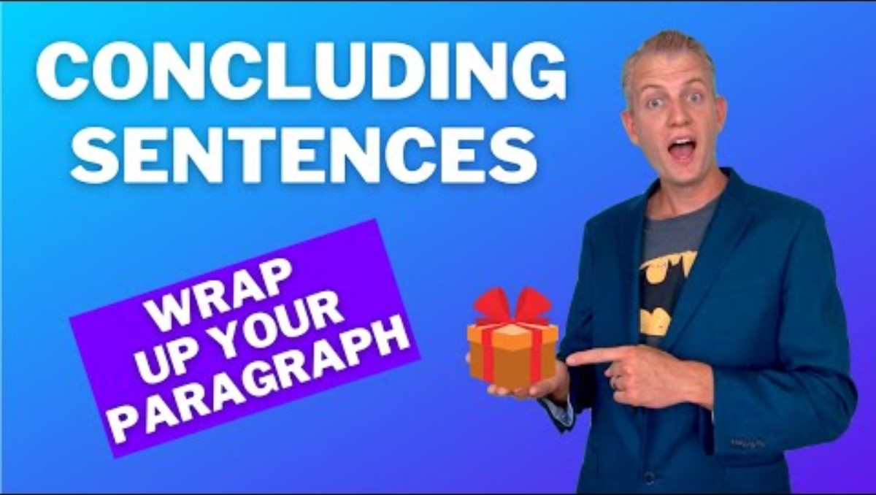
22
Concluding sentence needs focus or flair
Embed YouTube video here by going to insert> media> video > online video and copy and paste the link below (I can’t do this for you). You could also just delete this box and have the link. If your school blocks YouTube, you can simply take all this out and just rely on the written mini lesson and mentor sentences. Or, you could download the YouTube video and insert from your device.
The end of each body paragraph should provide a concluding sentence which ties to ideas in the thesis and topic sentence, but it should also bring the paragraph to a concise close and transition to the next idea.
Try including transitional statements to move from one idea to another without choppiness.
https://www.youtube.com/watch?v=WTkUGlg9uGw
More Practice:
Explore some sample conclusion statements here: https://writingcenter.ashford.edu/body-paragraphs
or here: https://writingcenter.unc.edu/tips-and-tools/conclusions/
Grammar Lessons
Style Lessons

Slide 25
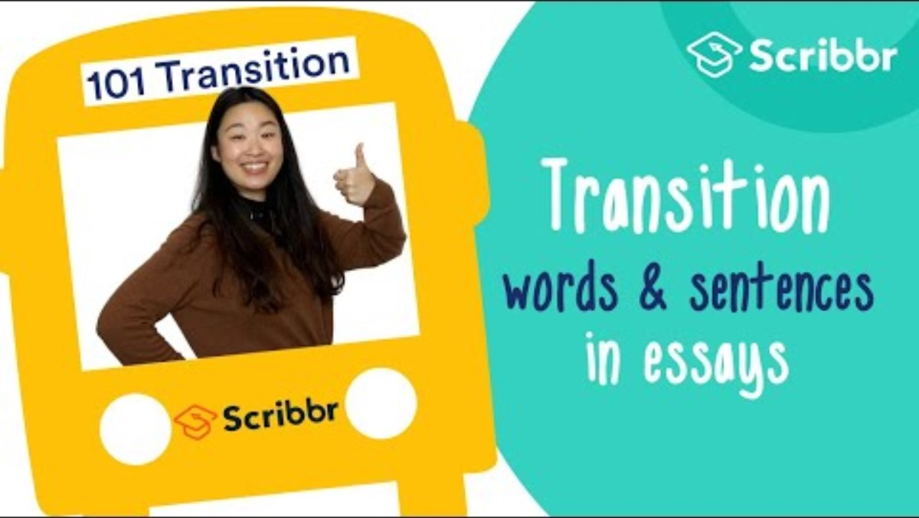
23
Transitions need clarity or variety
Embed YouTube video here by going to insert> media> video > online video and copy and paste the link below (I can’t do this for you). You could also just delete this box and have the link. If your school blocks YouTube, you can simply take all this out and just rely on the written mini lesson and mentor sentences. Or, you could download the YouTube video and insert from your device.
Clear transitions help you move from one point to another in your writing. It’s tempting to throw in a transitional word at the beginning of a new paragraph and think it’s sufficient, but transitions should be thoughtful and varied. Add a clarifying phrase after a transitional word to create a logical flow to your writing.
Examples:
In addition to the previous point…
While others may disagree…
As previously stated…
https://www.youtube.com/watch?v=CpDTxvxuFpM
More Practice:
Explore further here: https://www.niu.edu/writingtutorial/organization/transitions.shtml
Grammar Lessons
Style Lessons

Slide 26

24
Conclusion needs variety or flair
Embed YouTube video here by going to insert> media> video > online video and copy and paste the link below (I can’t do this for you). You could also just delete this box and have the link. If your school blocks YouTube, you can simply take all this out and just rely on the written mini lesson and mentor sentences. Or, you could download the YouTube video and insert from your device.
Here are some ideas to help when writing conclusions:
Answer the question, “So, what?” Why should anyone care? How does the topic affect the world around you and your audience?
Make it personal. Tell a relatable anecdote that ties into the topic and brings the point full circle.
End with a powerful message. Make the ending resonate with the audience. Make them want to take action or ponder a new insight.
Tie back to an idea presented in your hook to create a framing device in opening and closing your writing.
https://www.youtube.com/watch?v=lv8tLxFVGuw
More Practice:
Explore further here: https://www.niu.edu/writingtutorial/organization/conclusion.shtml
Grammar Lessons
Style Lessons

Slide 27
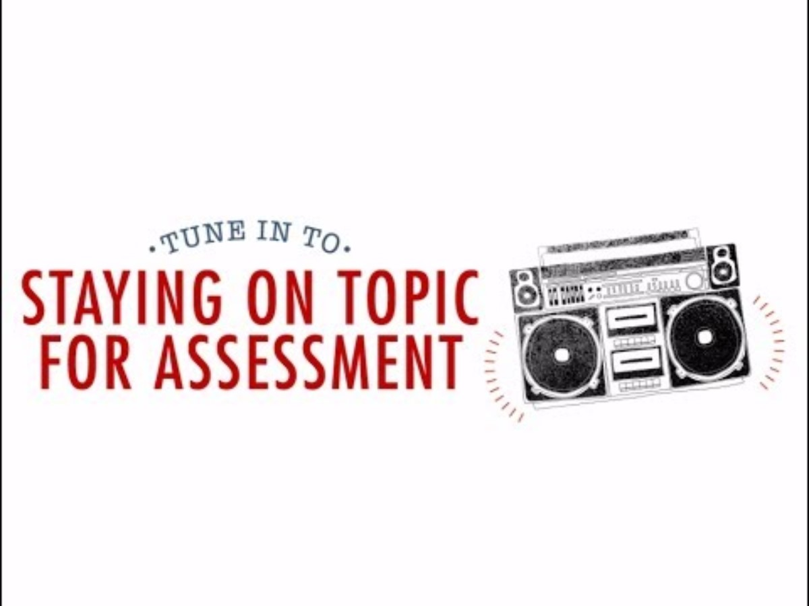
25
Details are irrelevant or invalid
Embed YouTube video here by going to insert> media> video > online video and copy and paste the link below (I can’t do this for you). You could also just delete this box and have the link. If your school blocks YouTube, you can simply take all this out and just rely on the written mini lesson and mentor sentences. Or, you could download the YouTube video and insert from your device.
Clarity is extremely important in writing. Sometimes, what makes sense to us doesn’t always come across clearly to others. We may fill in the blanks in our heads, but a reader may miss the connection.
Try to think like your audience and consider their perspective. Who are they? How can you write in a way that they will understand? More often than not, this requires more specific word choice and further explanation.
https://www.youtube.com/watch?v=-Bpz1Yn42_4
More Practice:
How to stay on topic: https://www.theclassroom.com/stay-topic-writing-essay-30818.html
Grammar Lessons
Style Lessons

Slide 28

26
Elaboration or connection needed
Embed YouTube video here by going to insert> media> video > online video and copy and paste the link below (I can’t do this for you). You could also just delete this box and have the link. If your school blocks YouTube, you can simply take all this out and just rely on the written mini lesson and mentor sentences. Or, you could download the YouTube video and insert from your device.
Dropping in quotes or pieces of evidence without explanation will not help to support your thesis. A quote cannot be a standalone sentence in your writing, and evidence can’t speak for itself.
As A.A. Milne quips, “[A] quotation is a handy thing to have about, saving one the trouble of thinking for oneself, always a laborious business."
Avoid plopping in a quote without your own elaboration or explanation. Analyze and develop how that evidence contributes to the topic.
https://www.youtube.com/watch?v=CjyYo6RLeDc
More Practice:
Explore further here:
https://abington.psu.edu/ice-introduce-cite-and-explain-your-evidence
Grammar Lessons
Style Lessons

Slide 29
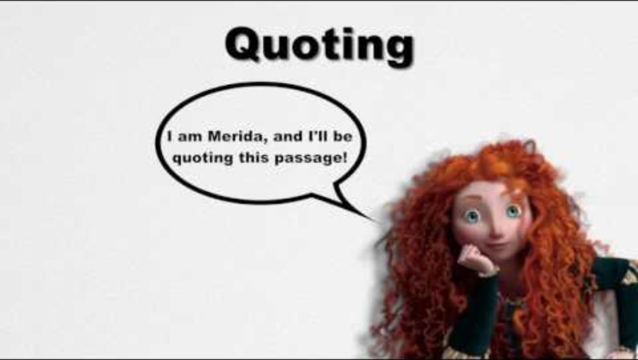
27
Support of claim needed
Embed YouTube video here by going to insert> media> video > online video and copy and paste the link below (I can’t do this for you). You could also just delete this box and have the link. If your school blocks YouTube, you can simply take all this out and just rely on the written mini lesson and mentor sentences. Or, you could download the YouTube video and insert from your device.
Good writing requires evidence.
Quotations:
When you quote, you are reproducing another writer’s words exactly as they appear on the page. Use quotation marks around the quote to indicate that the words are not your own. Only use direct quotes if there is no way to appropriately capture the essence of what the author is saying through paraphrasing. Be sure to introduce each quote by framing it within your own language, and always cite your sources.
Paraphrasing:
When you paraphrase, you take a specific section of an outside source and rewrite it in your own words. Because you are relying on another’s work to paraphrase the information, you still must cite your source.
https://www.youtube.com/watch?v=pGQPYJUyWj4
More Practice:
Explore further:
https://courses.lumenlearning.com/engcomp1-wmopen/chapter/1-4-supporting-claims-text/
Grammar Lessons
Style Lessons

Slide 30
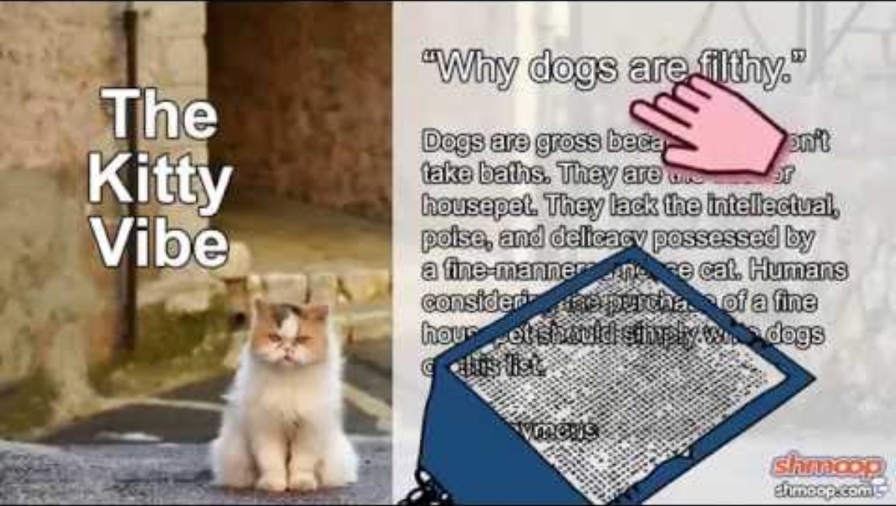
28
Source needs reevaluated for validity
Embed YouTube video here by going to insert> media> video > online video and copy and paste the link below (I can’t do this for you). You could also just delete this box and have the link. If your school blocks YouTube, you can simply take all this out and just rely on the written mini lesson and mentor sentences. Or, you could download the YouTube video and insert from your device.
In the age of fake news, finding and recognizing credible sources is more important than ever.
Check your source for the following:
Who is the author and are they an expert in their field?
How recent is the source? Is it still valid?
What is the author’s purpose? Are they biased?
Does the website look trustworthy?
https://www.youtube.com/watch?v=m_EAxomGhNY
More Practice:
How to determine a valid source: https://myelms.umd.edu/courses/1082806/pages/what-is-a-good-source-determining-the-validity-of-evidence
The CRAP test: https://libguides.southmountaincc.edu/CRAPtest
Grammar Lessons
Style Lessons

Slide 31
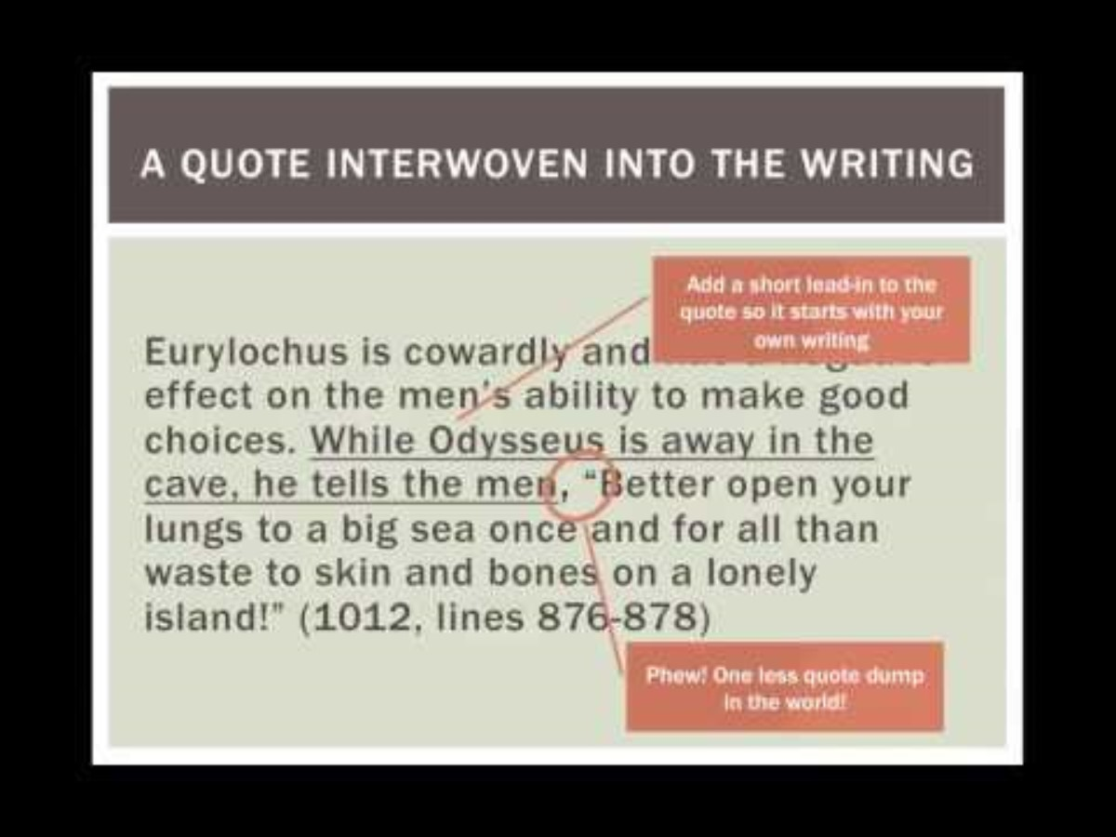
29
Embedded quote need elevated or corrected
Embed YouTube video here by going to insert> media> video > online video and copy and paste the link below (I can’t do this for you). You could also just delete this box and have the link. If your school blocks YouTube, you can simply take all this out and just rely on the written mini lesson and mentor sentences. Or, you could download the YouTube video and insert from your device.
You must embed ALL quotes. No quotation can act as a standalone sentence in your writing. Quotes can’t float! You either embed the quote into a sentence of your own, or you introduce the quote.
Stephen King articulates the importance of an opening line by asserting, “an opening line should invite the reader to begin the story. It should say: Listen. Come in here. You want to know about this” (1).
He wants us to ponder, “How can a writer extend an appealing invitation -- one that's difficult, even, to refuse?”(qtd. in Fassler).
For further citation rules, visit Purdue OWL MLA Writing Guide
https://www.youtube.com/watch?v=Pedp6_WlVsM
More Practice:
Embedding a quote: https://writingcenter.unc.edu/tips-and-tools/quotations/
Grammar Lessons
Style Lessons

Slide 32
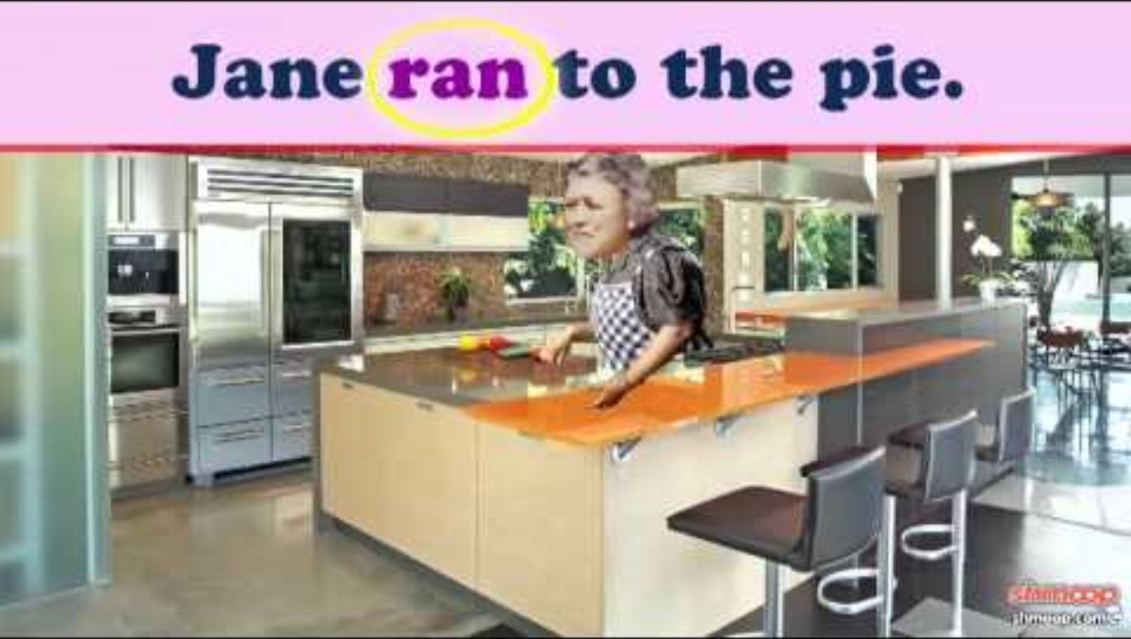
30
Vocabulary needs to be vivid or varied
Embed YouTube video here by going to insert> media> video > online video and copy and paste the link below (I can’t do this for you). You could also just delete this box and have the link. If your school blocks YouTube, you can simply take all this out and just rely on the written mini lesson and mentor sentences. Or, you could download the YouTube video and insert from your device.
Vivid writing helps create a clear picture in the reader’s mind. Be sure to select specific language that is descriptive and relevant.
Avoid words like “good” or “bad” that overgeneralize. Instead, use vocabulary that clearly communicates your point. “Good” can mean “delicious” or “talented” or “excited”; “Bad” can mean “foul” or “weak” or “terrified.” For these words, and many others, ask yourself if you’re using the most descriptive and appropriate word for the situation.
Remember, put yourself in your audience’s shoes and think from their perspective.
https://www.youtube.com/watch?v=NlaeV-TH8WE
More Practice:
Replacements for overused words: https://www.academia.edu/7979615/Alternatives_for_Overused_Words
Grammar Lessons
Style Lessons

Slide 33
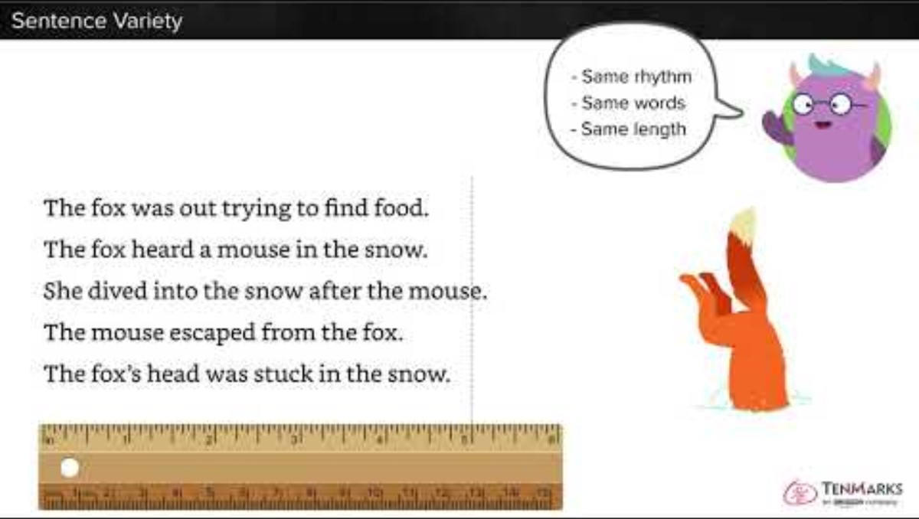
31
Sentence variety needed
Embed YouTube video here by going to insert> media> video > online video and copy and paste the link below (I can’t do this for you). You could also just delete this box and have the link. If your school blocks YouTube, you can simply take all this out and just rely on the written mini lesson and mentor sentences. Or, you could download the YouTube video and insert from your device.
Varied sentence lengths and structures build interest and erase monotony or unnecessary repetition from your writing.
Pay attention to the way you begin and end each sentence. You might be starting every sentence with the word “The” without even realizing it! If you have several short sentences that all follow the same subject-verb-object structure, mix it up by combining sentences, using introductory clauses/phrases, or incorporating transition words.
https://www.youtube.com/watch?v=q7MTrpRC_70
More Practice:
Sentence variety examples: https://owl.purdue.edu/owl/general_writing/academic_writing/sentence_variety/index.html
Grammar Lessons
Style Lessons

Slide 34
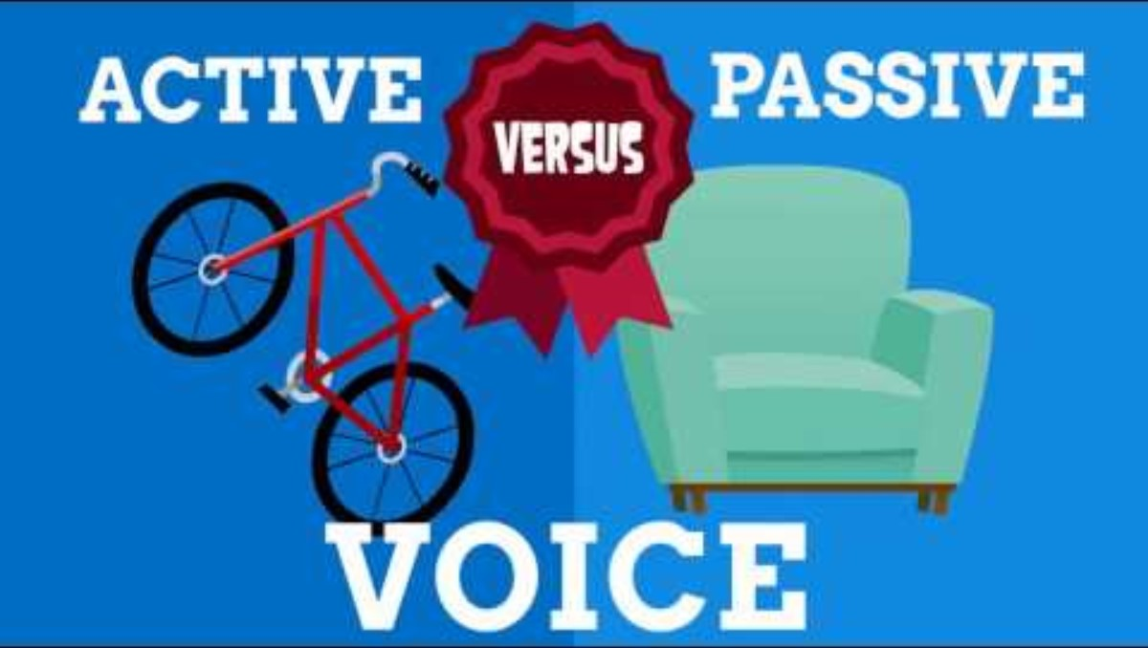
32
Passive voice consideration
Embed YouTube video here by going to insert> media> video > online video and copy and paste the link below (I can’t do this for you). You could also just delete this box and have the link. If your school blocks YouTube, you can simply take all this out and just rely on the written mini lesson and mentor sentences. Or, you could download the YouTube video and insert from your device.
Even though passive voice is grammatically correct, it is not supposed to be used in most forms of writing (technical writing such as science experiments is an exception). The ACT and most English teachers will deduct points for passive voice. To avoid passive voice, make sure that the subject of the sentence performs the action.
Examples:
Passive: The book was being read by Joy.
Active: Joy read the book.
Passive: The books were stolen from the library.
Active: A book thief stole the books from the library.
https://www.youtube.com/watch?v=W1_IRU6zx9g
More Practice:
When to avoid passive voice:
https://advice.writing.utoronto.ca/revising/passive-voice/
Ideas for adding more of your voice to your writing:
https://www.brighthubeducation.com/help-with-writing/33000-using-personal-voice-in-writing/
Grammar Lessons
Style Lessons

Slide 35
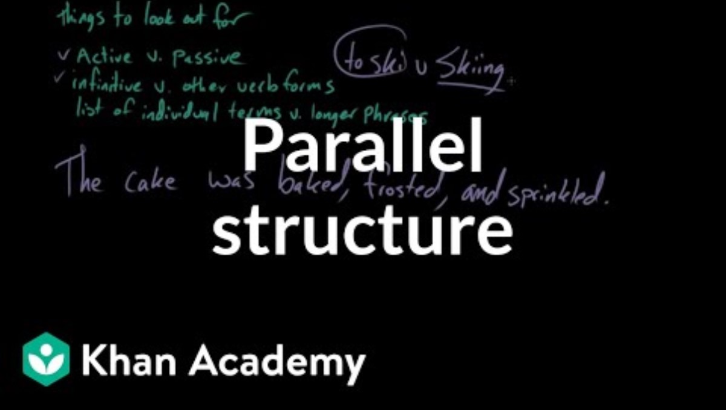
33
Parallel structure consideration
Embed YouTube video here by going to insert> media> video > online video and copy and paste the link below (I can’t do this for you). You could also just delete this box and have the link. If your school blocks YouTube, you can simply take all this out and just rely on the written mini lesson and mentor sentences. Or, you could download the YouTube video and insert from your device.
Parallel structure refers to a balance of similar grammatical structure in phrases, clauses or sentences. All things in a list must follow the same grammatical order to form parallelism.
Parallel Structure:
Reading gives life to the heart.
Writing offers peace to the mind.
Learning delivers growth to the soul.
Parallel Sentence Structure:
I love to read new books, visit different bookstores, and write witty reviews.
https://www.youtube.com/watch?v=2l2FgUrln1A
More Practice:
Parallel Structure:
https://owl.purdue.edu/owl/general_writing/mechanics/parallel_structure.html
Grammar Lessons
Style Lessons

Slide 36
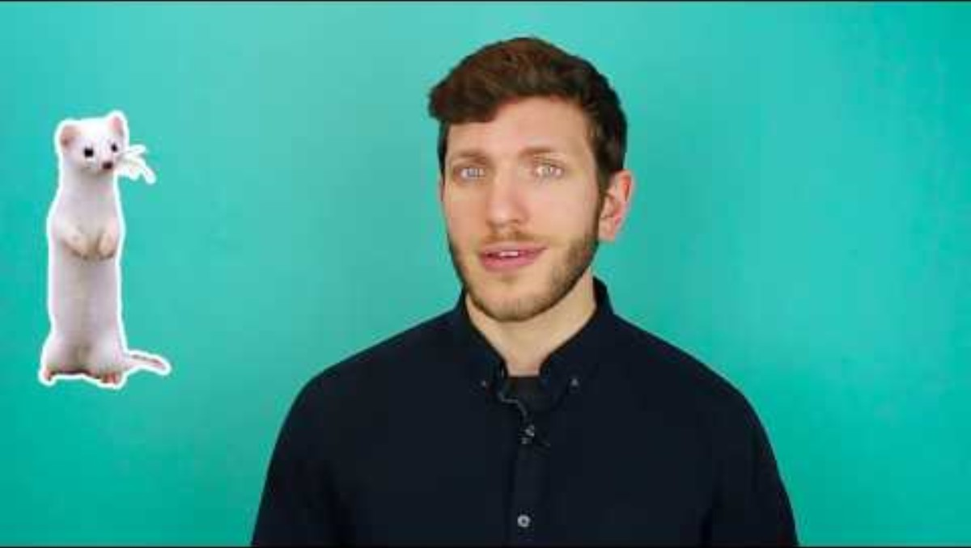
34
Wordiness or unclear cohesion
Embed YouTube video here by going to insert> media> video > online video and copy and paste the link below (I can’t do this for you). You could also just delete this box and have the link. If your school blocks YouTube, you can simply take all this out and just rely on the written mini lesson and mentor sentences. Or, you could download the YouTube video and insert from your device.
Avoid wordiness by eliminating unnecessary qualifiers (like, such as, very, really, maybe, perhaps, etc.) and limiting redundant word use. If a word is not necessary to convey the meaning of the sentence, remove it. This editing can help improve the cohesiveness of your ideas by eliminating weak, fluffy language.
Wordy: He really enjoyed reading graphic novels.
Revision: He enjoyed reading graphic novels.
Wordy: The book made him feel happy and joyful.
Revision: The book made him feel joyful.
https://www.youtube.com/watch?v=3IQBJ_fQ8k0
More Practice:
Explore further here:
https://www.niu.edu/writingtutorial/organization/revision-process.shtml
Grammar Lessons
Style Lessons

Slide 37
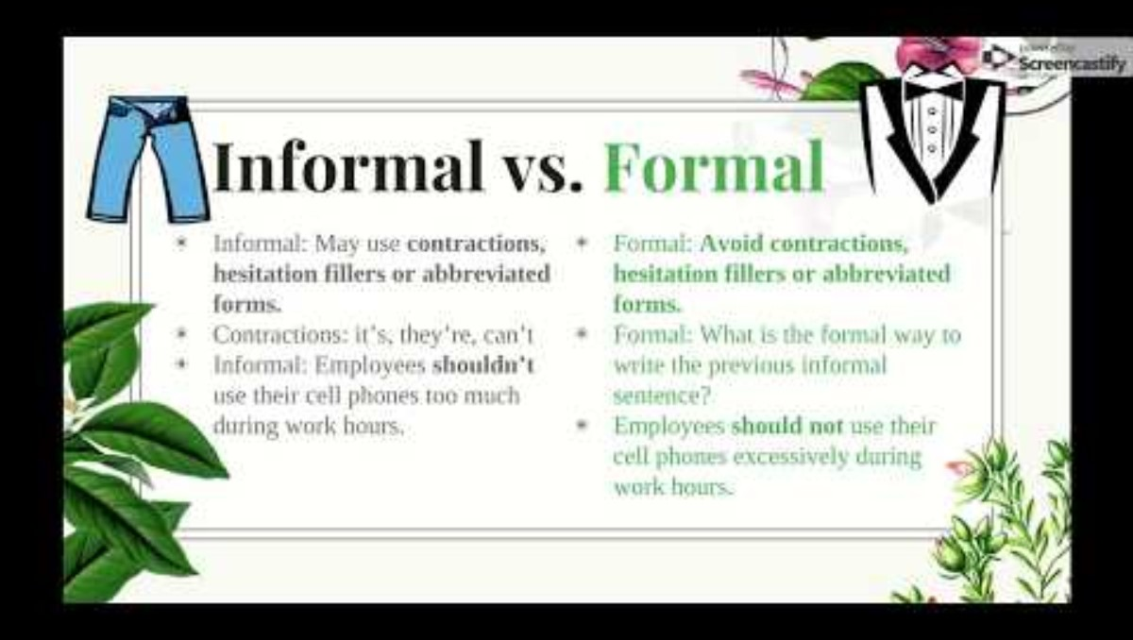
35
Tone consideration
Embed YouTube video here by going to insert> media> video > online video and copy and paste the link below (I can’t do this for you). You could also just delete this box and have the link. If your school blocks YouTube, you can simply take all this out and just rely on the written mini lesson and mentor sentences. Or, you could download the YouTube video and insert from your device.
Consider the required tone of a piece while you’re writing. If you’re writing a text to your teacher, you’ll probably use different words compared to how you speak to your closest friends. In formal essays, avoid using slang or “text talk” unless it is directly relevant to the subject. This is often referred to as an academic tone.
Examples:
Slang: Unfortunately, y’all missed the book fair.
Revision: Unfortunately, you all missed the book fair.
https://www.youtube.com/watch?v=S4Jtgg8iAZA
More Practice:
Explore further here:
https://owl.purdue.edu/owl/english_as_a_second_language/esl_students/audience_considerations_for_esl_writers/tone_and_purpose.html
Grammar Lessons
Style Lessons

Slide 38
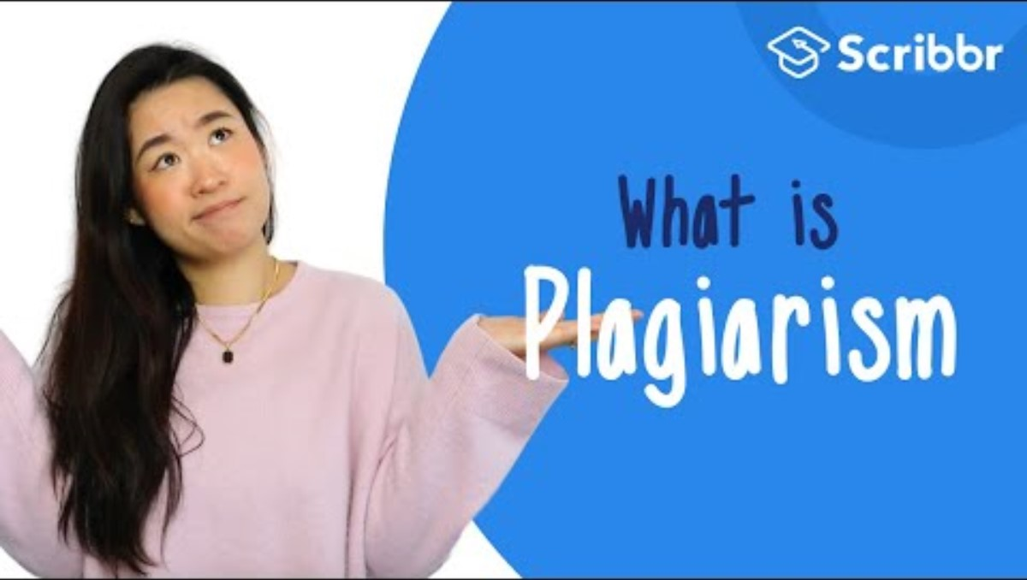
36
Plagiarism issues
Embed YouTube video here by going to insert> media> video > online video and copy and paste the link below (I can’t do this for you). You could also just delete this box and have the link. If your school blocks YouTube, you can simply take all this out and just rely on the written mini lesson and mentor sentences. Or, you could download the YouTube video and insert from your device.
Plagiarism is a very serious matter in the writing and academic world, so it’s important to know how to avoid its pitfalls.
Plagiarizing means taking someone else’s work and passing it off as your own. You must ALWAYS cite any sources you used, whether for quotes or paraphrasing, to give them credit. Changing one or two words in a sentence is not effective paraphrasing! You must completely rephrase the idea in your words and continue to cite the original source.
https://www.youtube.com/watch?v=Uk1pq8sb-eo
More Practice:
Explore further here: https://owl.purdue.edu/owl/avoiding_plagiarism/index.html
Grammar Lessons
Style Lessons

