Slide 1
COMPOSITION
Rules of Composition

Slide 2
What is composition?
The relative arrangement of the elements of photography within the frame of a photograph.
Composition is what separates TAKING from MAKING.
Anyone can take a snapshot and post it to social media, composition is one of the things that separate the photographers from the rest.

Slide 3
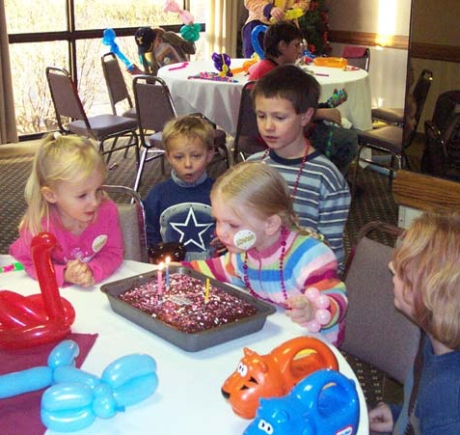
TAKING:
Snapshots
Recording a moment, not a lot of preplanned thought.
Common, everyday

Slide 4
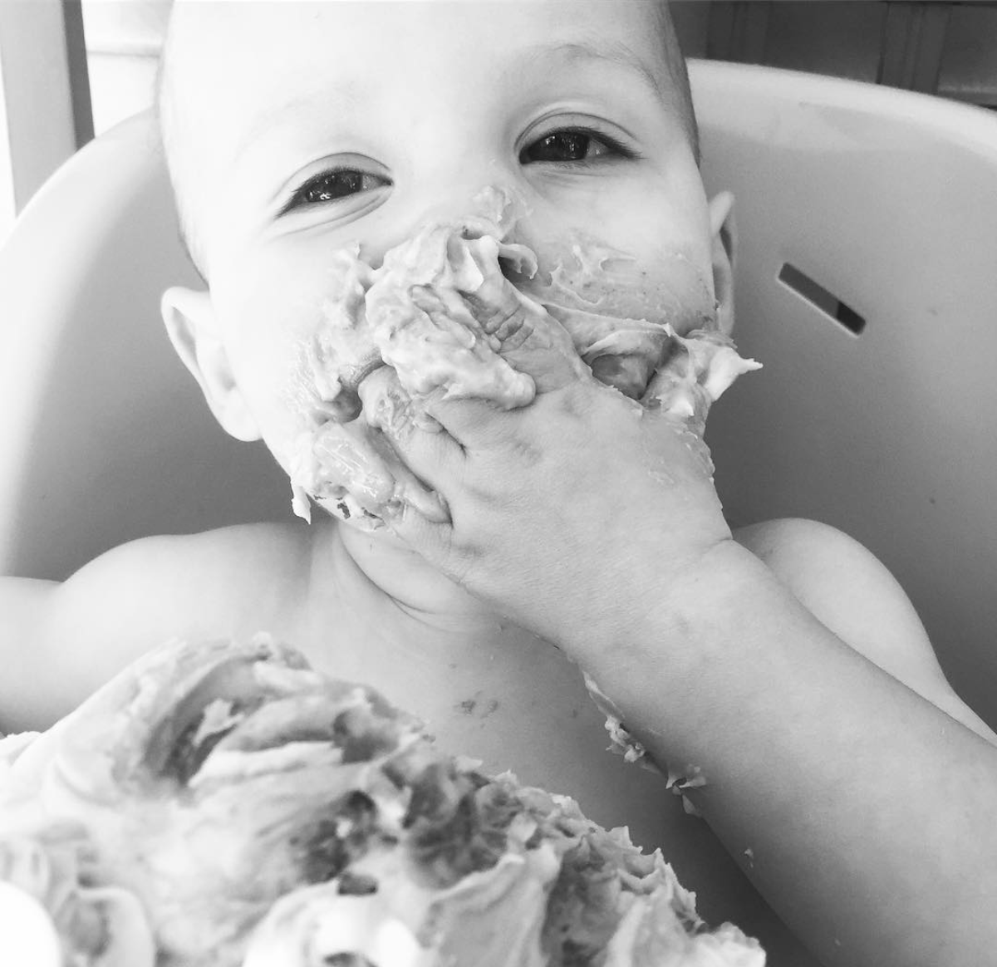
MAKING
Artistic and conscious control over the process.
Pre-visualization:
  “To visualize an image…to see it clearly in the mind prior to exposure and continuous projection from composing the image through the final print.” -Ansel Adams
  Waiting for the right moment, knowing when the right moment is.
Planning out the composition before taking the photograph and enhancing the composition in the editing process.

Slide 5
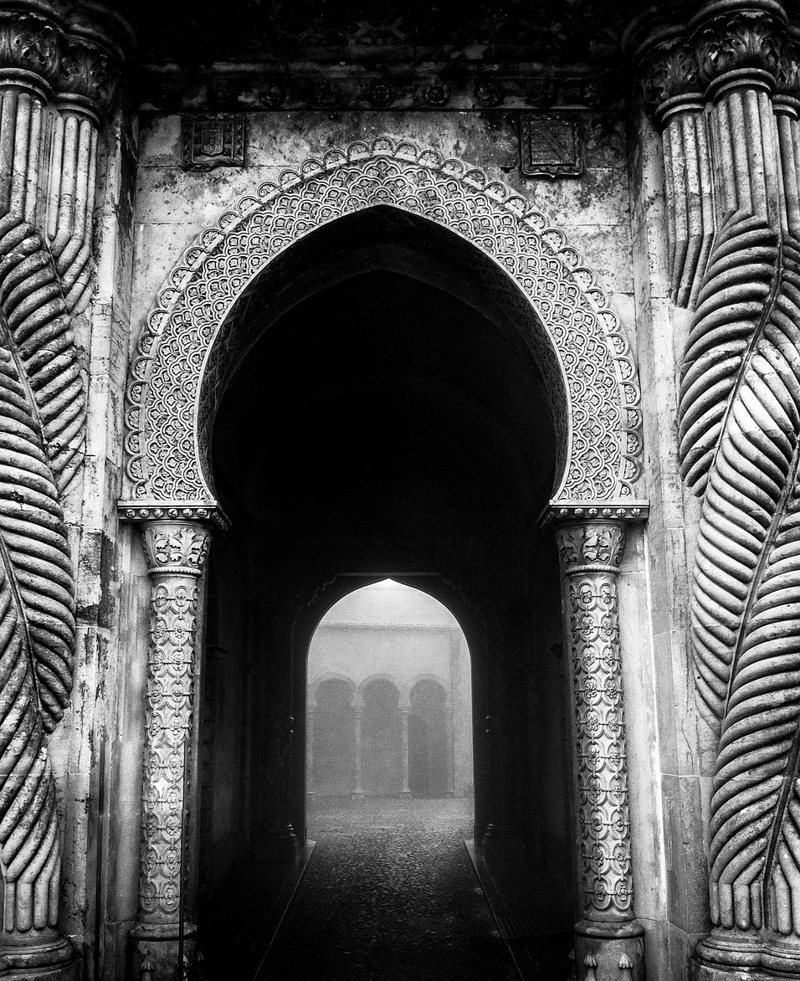
RULES OF COMPOSITION:
Rule of thirds
Balancing elements
Leading lines
Viewpoint
Inclusion and Exclusion
Experimentation
https://www.maxpixel.net/Uzaklar-Composition-Travel-Scully-Trip-Portugal-1852682

Slide 6

RULE OF THIRDS:
Focal Point should be positioned at one of these points.
Moving the focal point out of the center and into one of the “third” sections of the photograph frame.
If you’ve ever used the crop tool on Instagram, this exact diagram pops up over your image. Even social media tools recognize this is a good rule of composition.

Slide 7
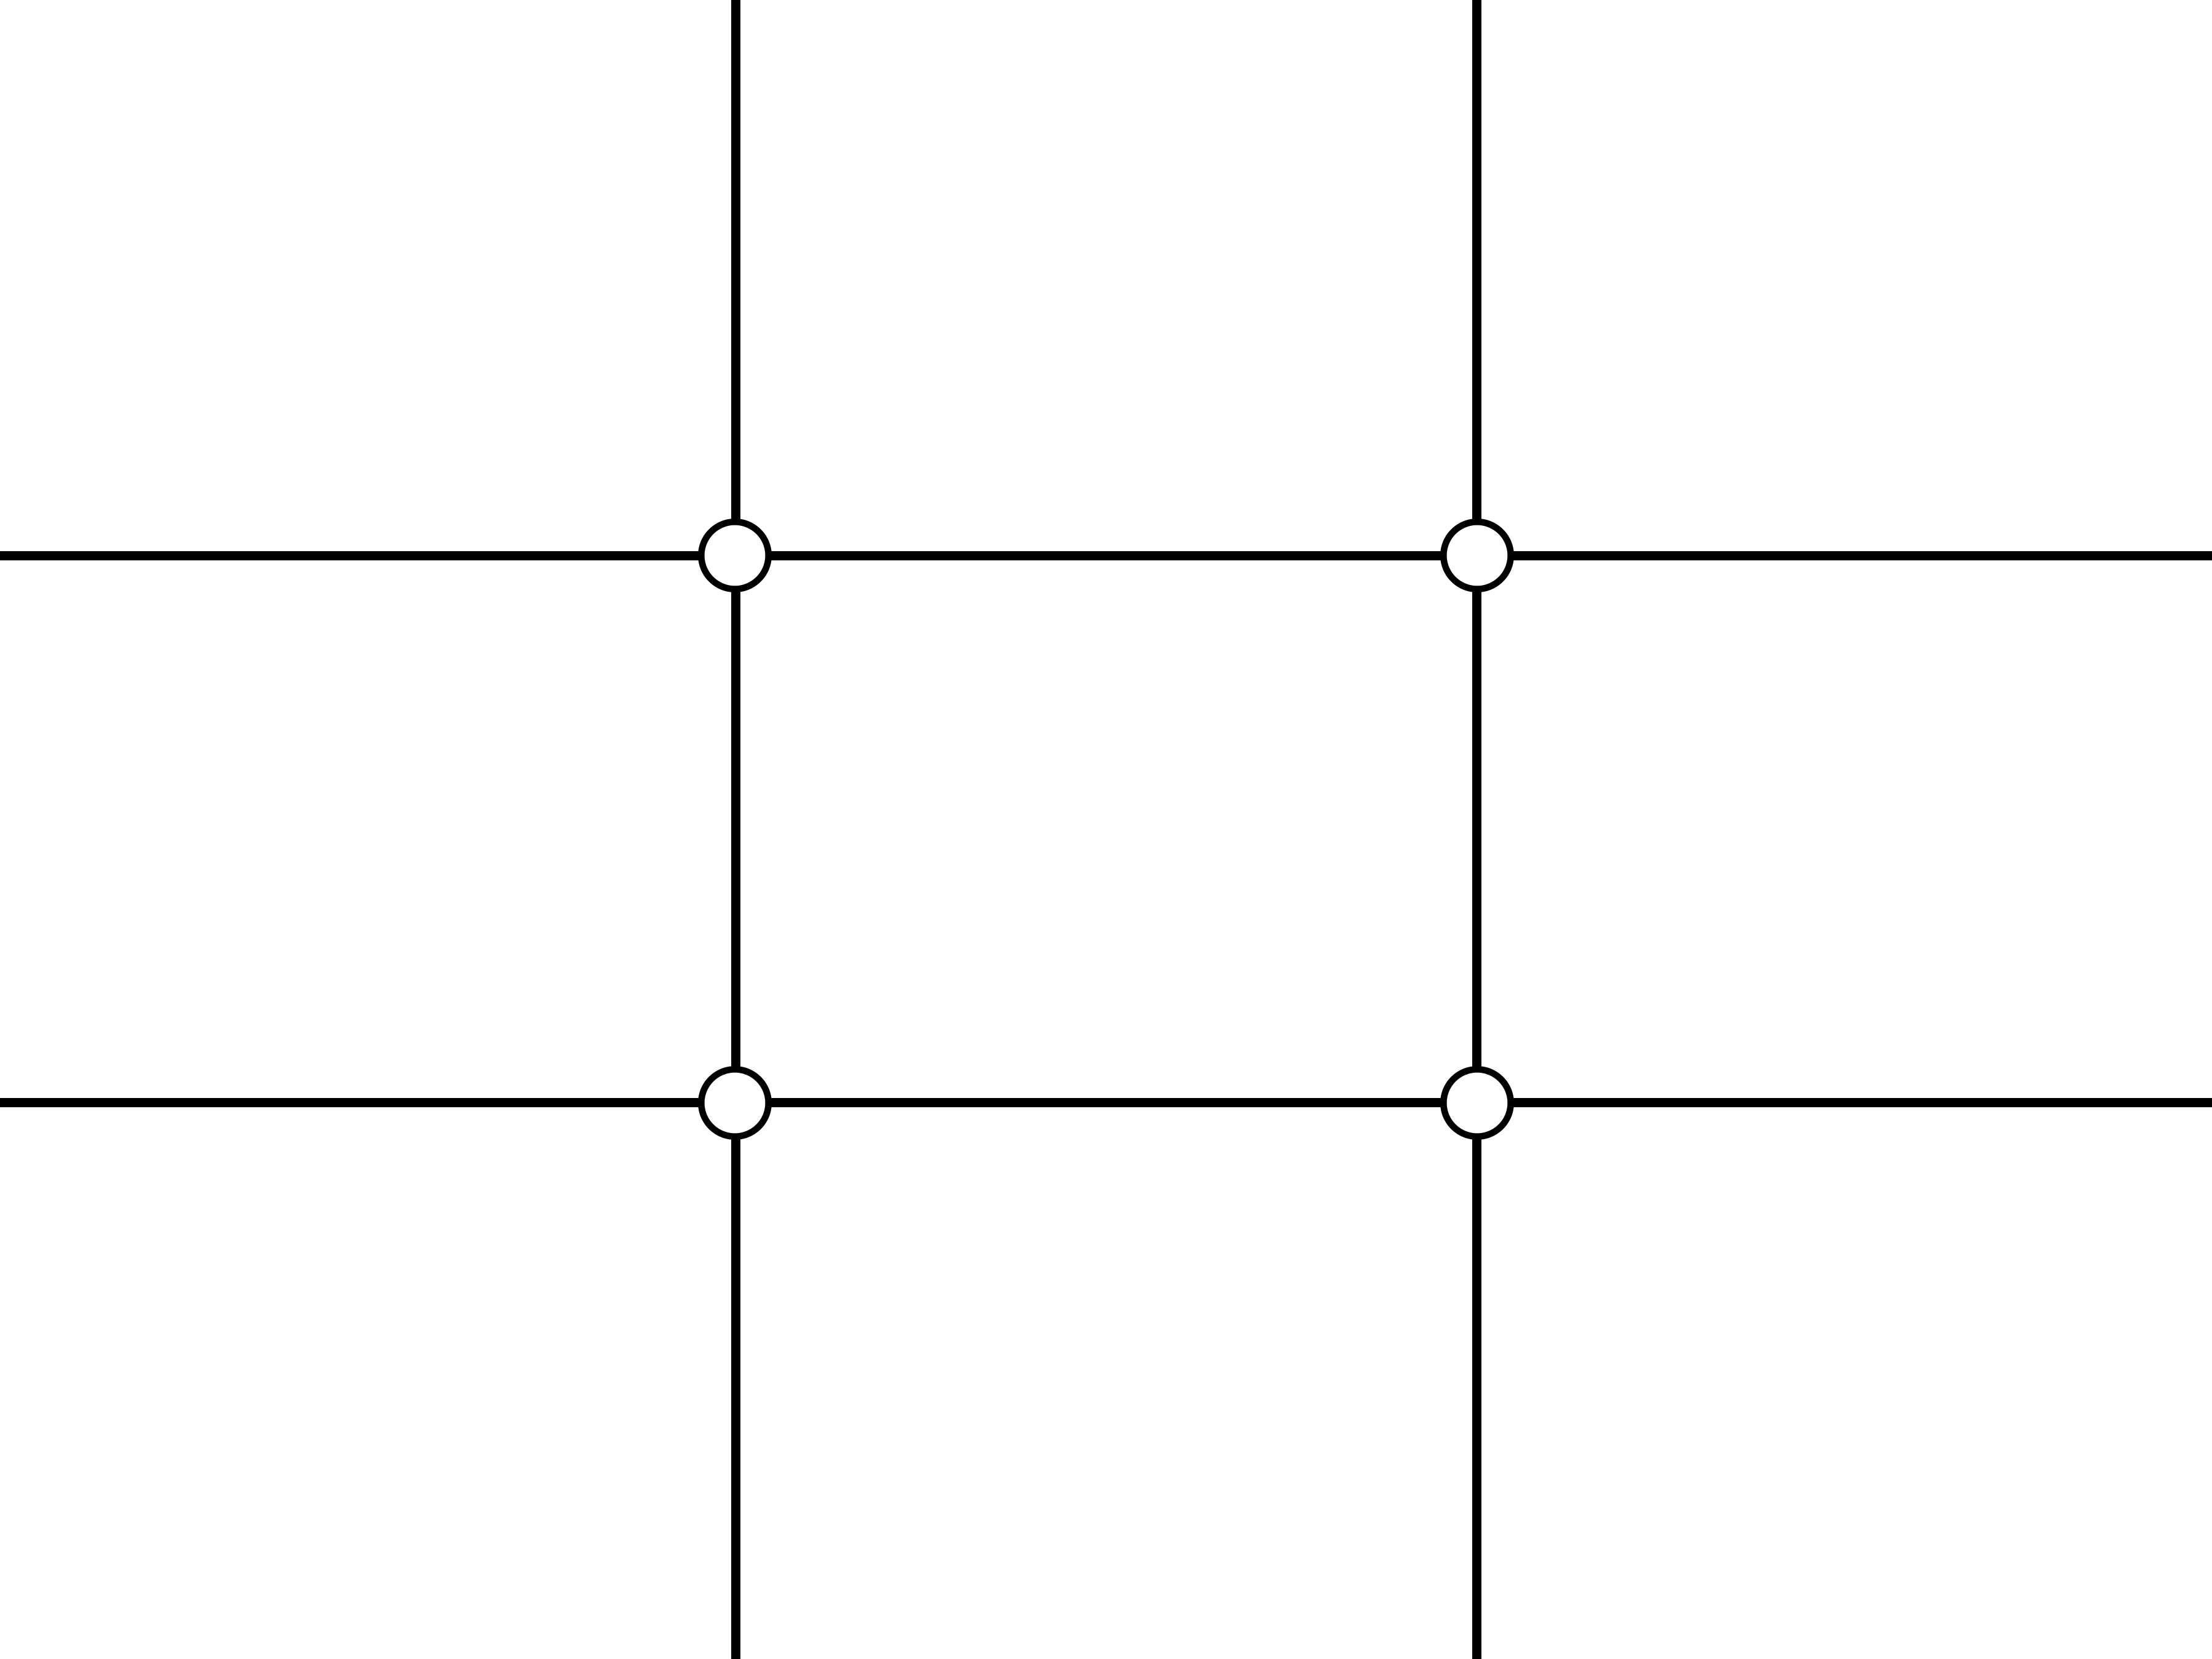
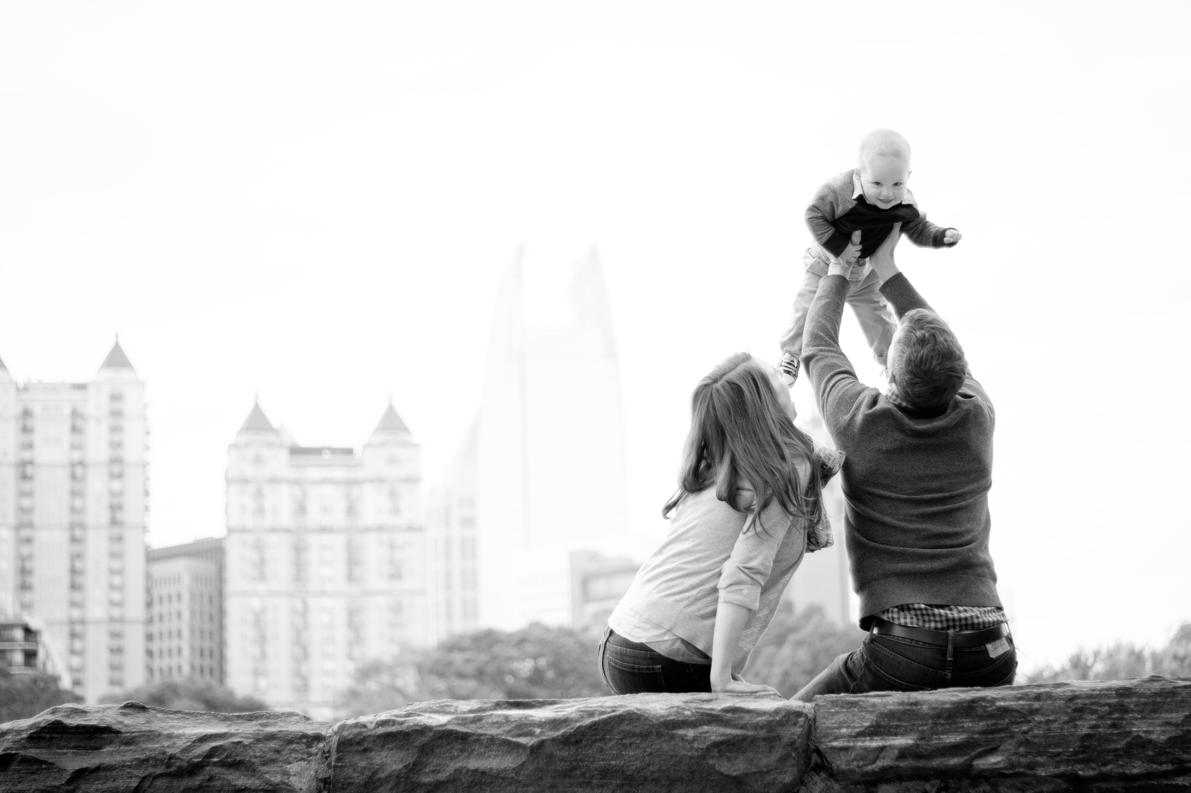
Rule of thirds:

Slide 8
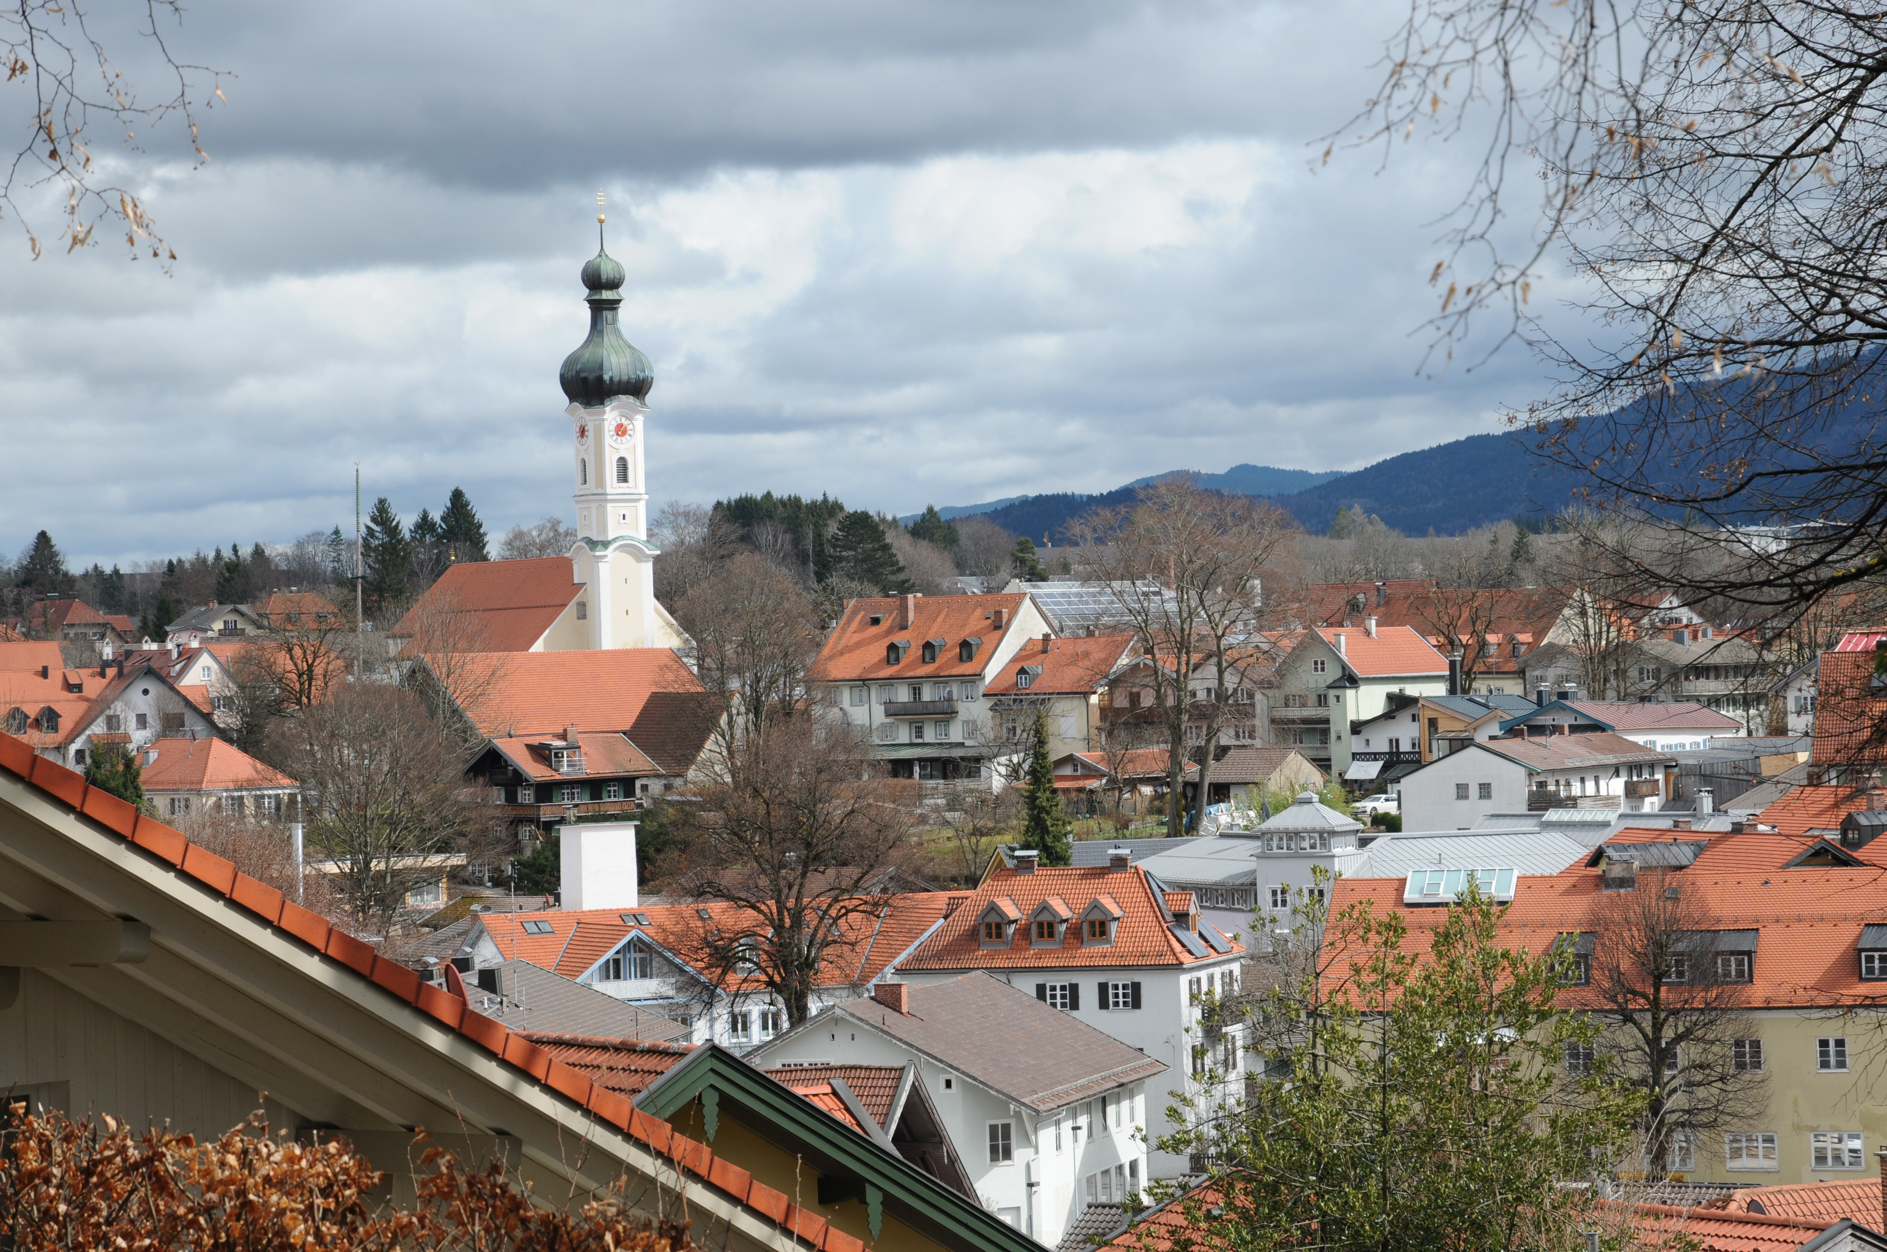

Slide 9
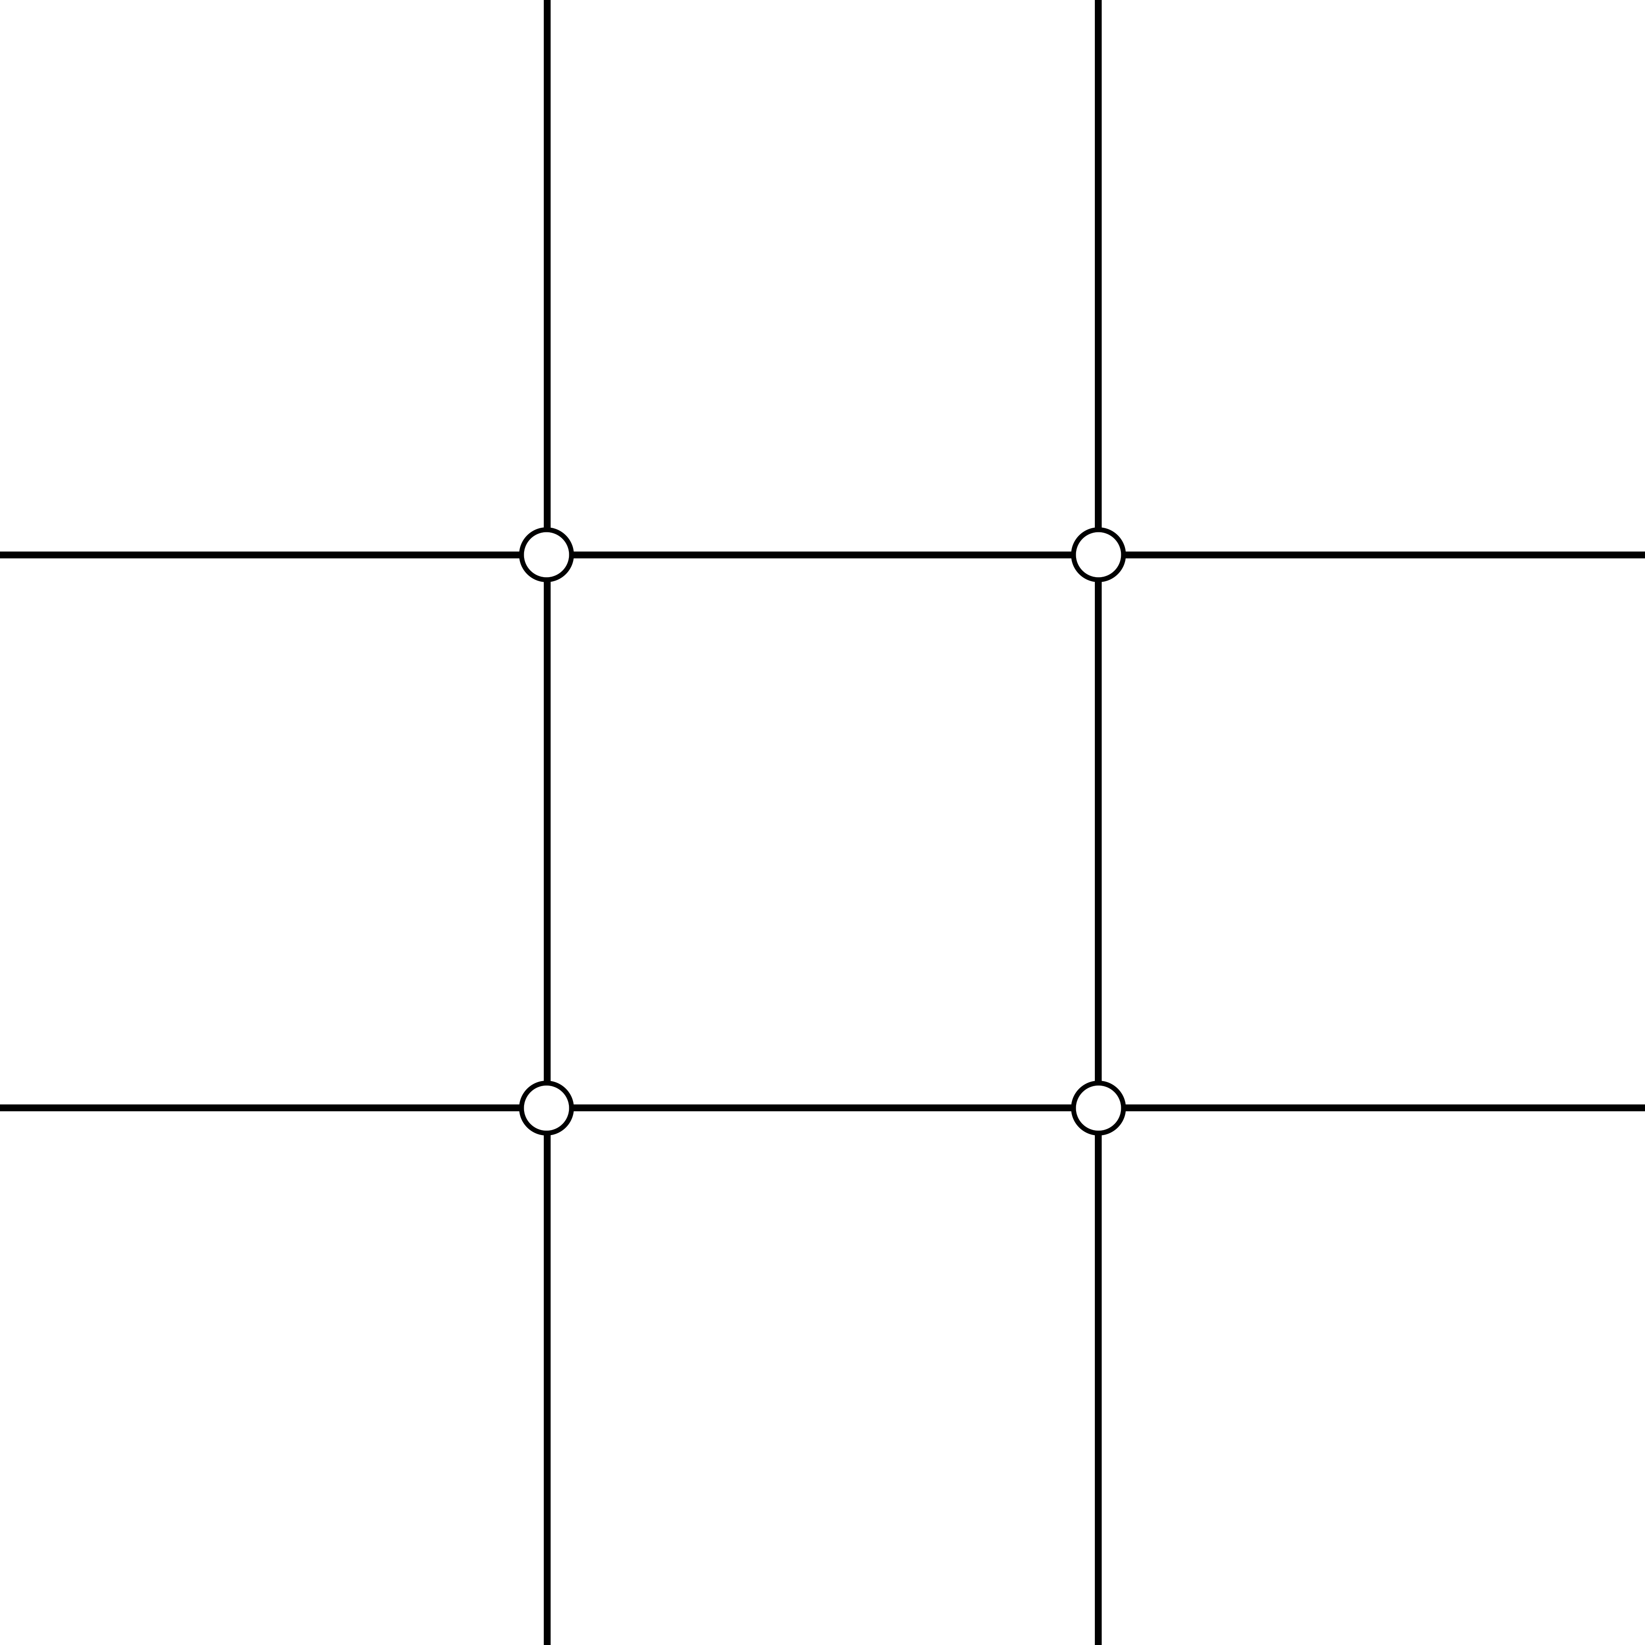
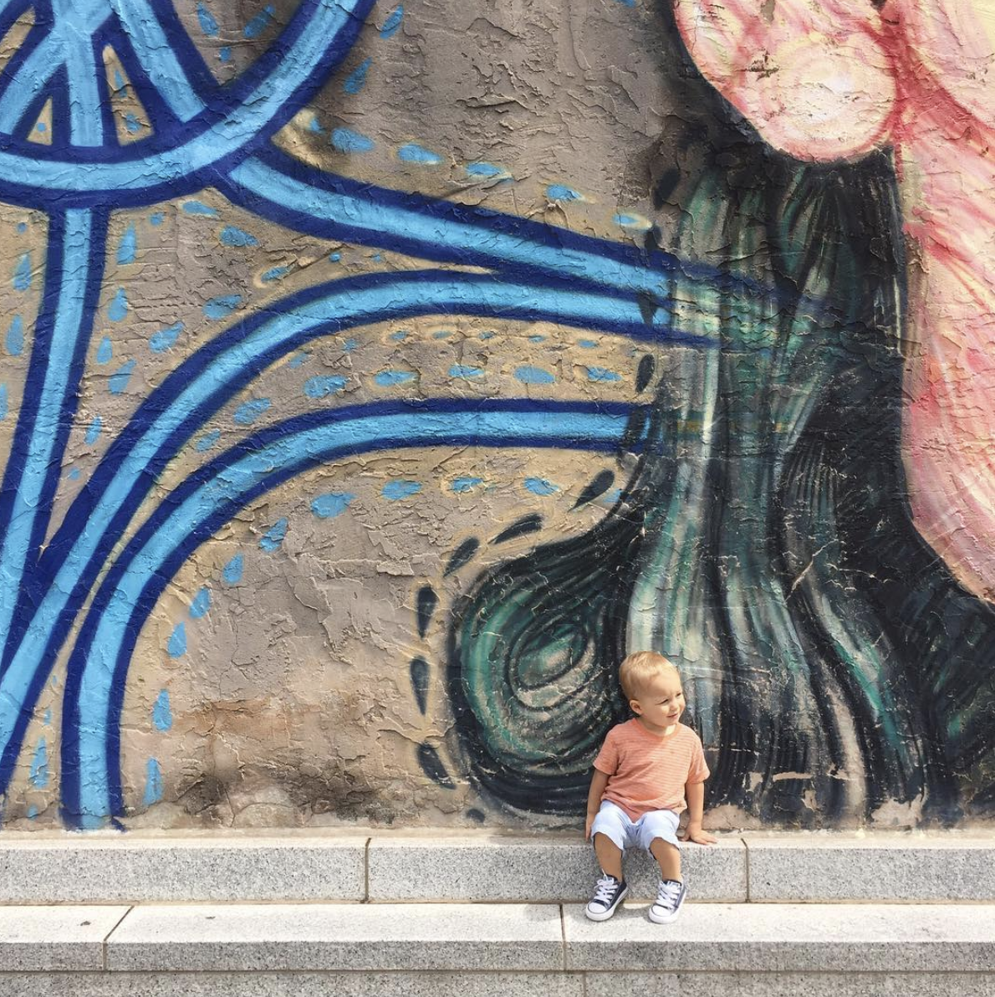

Slide 10
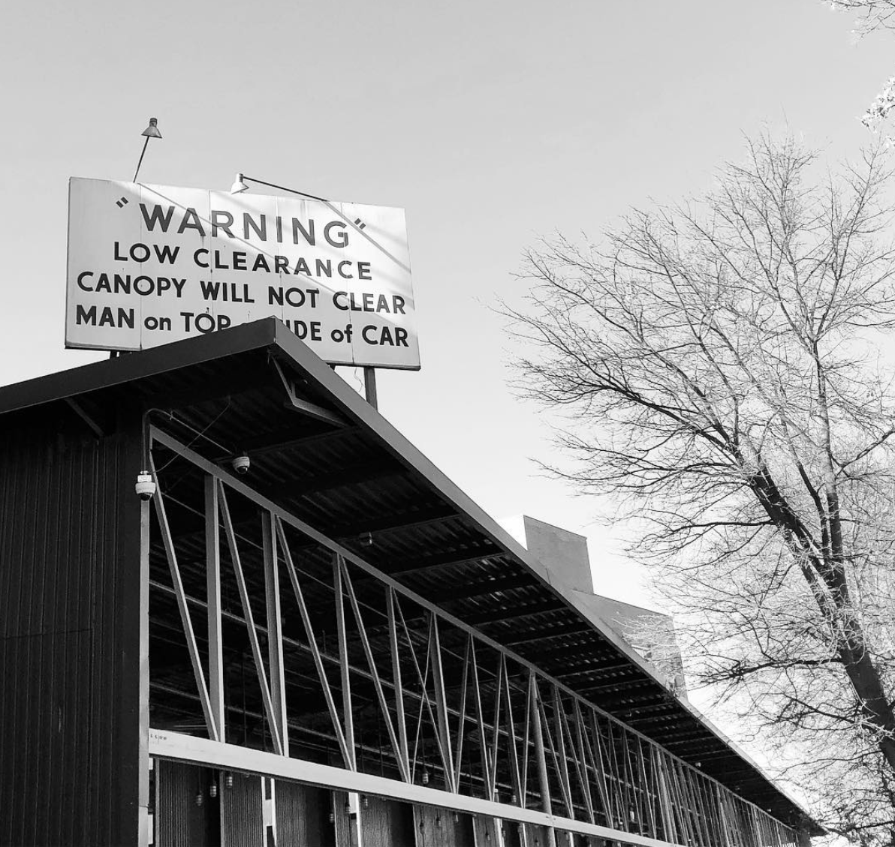
BALANCING ELEMENTS
Airy feeling tree.
Light sign.
Although the rule of thirds creates a more pleasing and interesting image, it runs the risk of creating an unbalanced image.
Consider the weight of your objects. If one thing feels too heavy, balance it with another element.
There are two types of balance: formal, or symmetrical, and informal or asymmetrical.
Asymmetrical balance pairs well with the rule of thirds.
Dark, heavy feeling building.

Slide 11
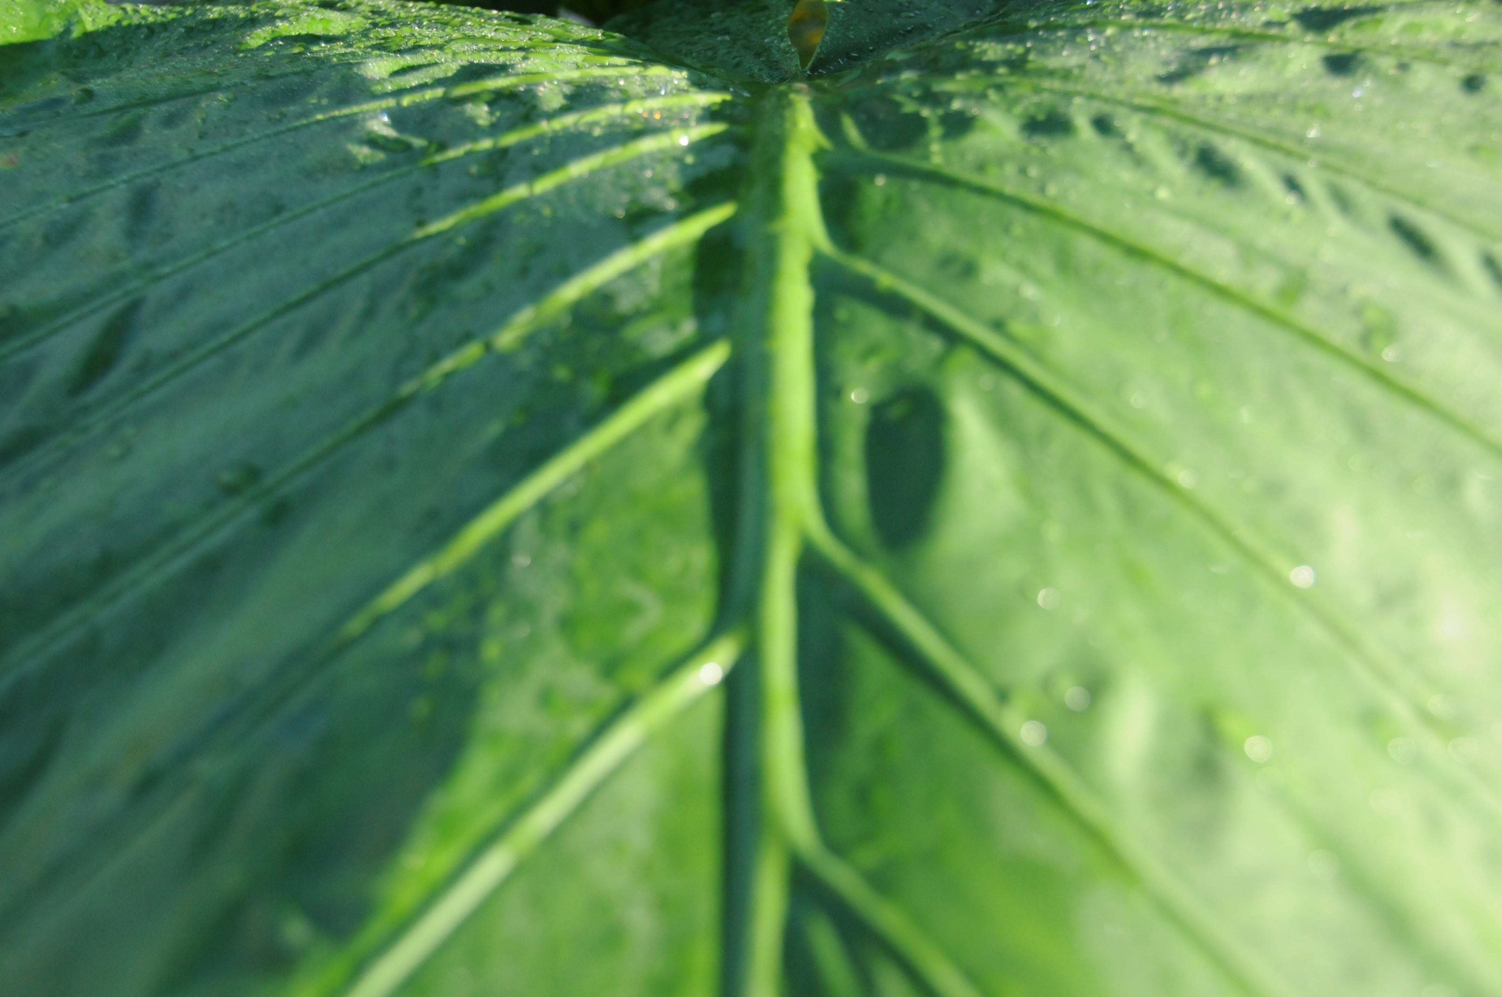
FORMAL BALANCE

Slide 12
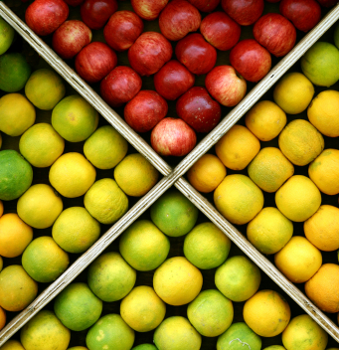
FORMAL BALANCE

Slide 13
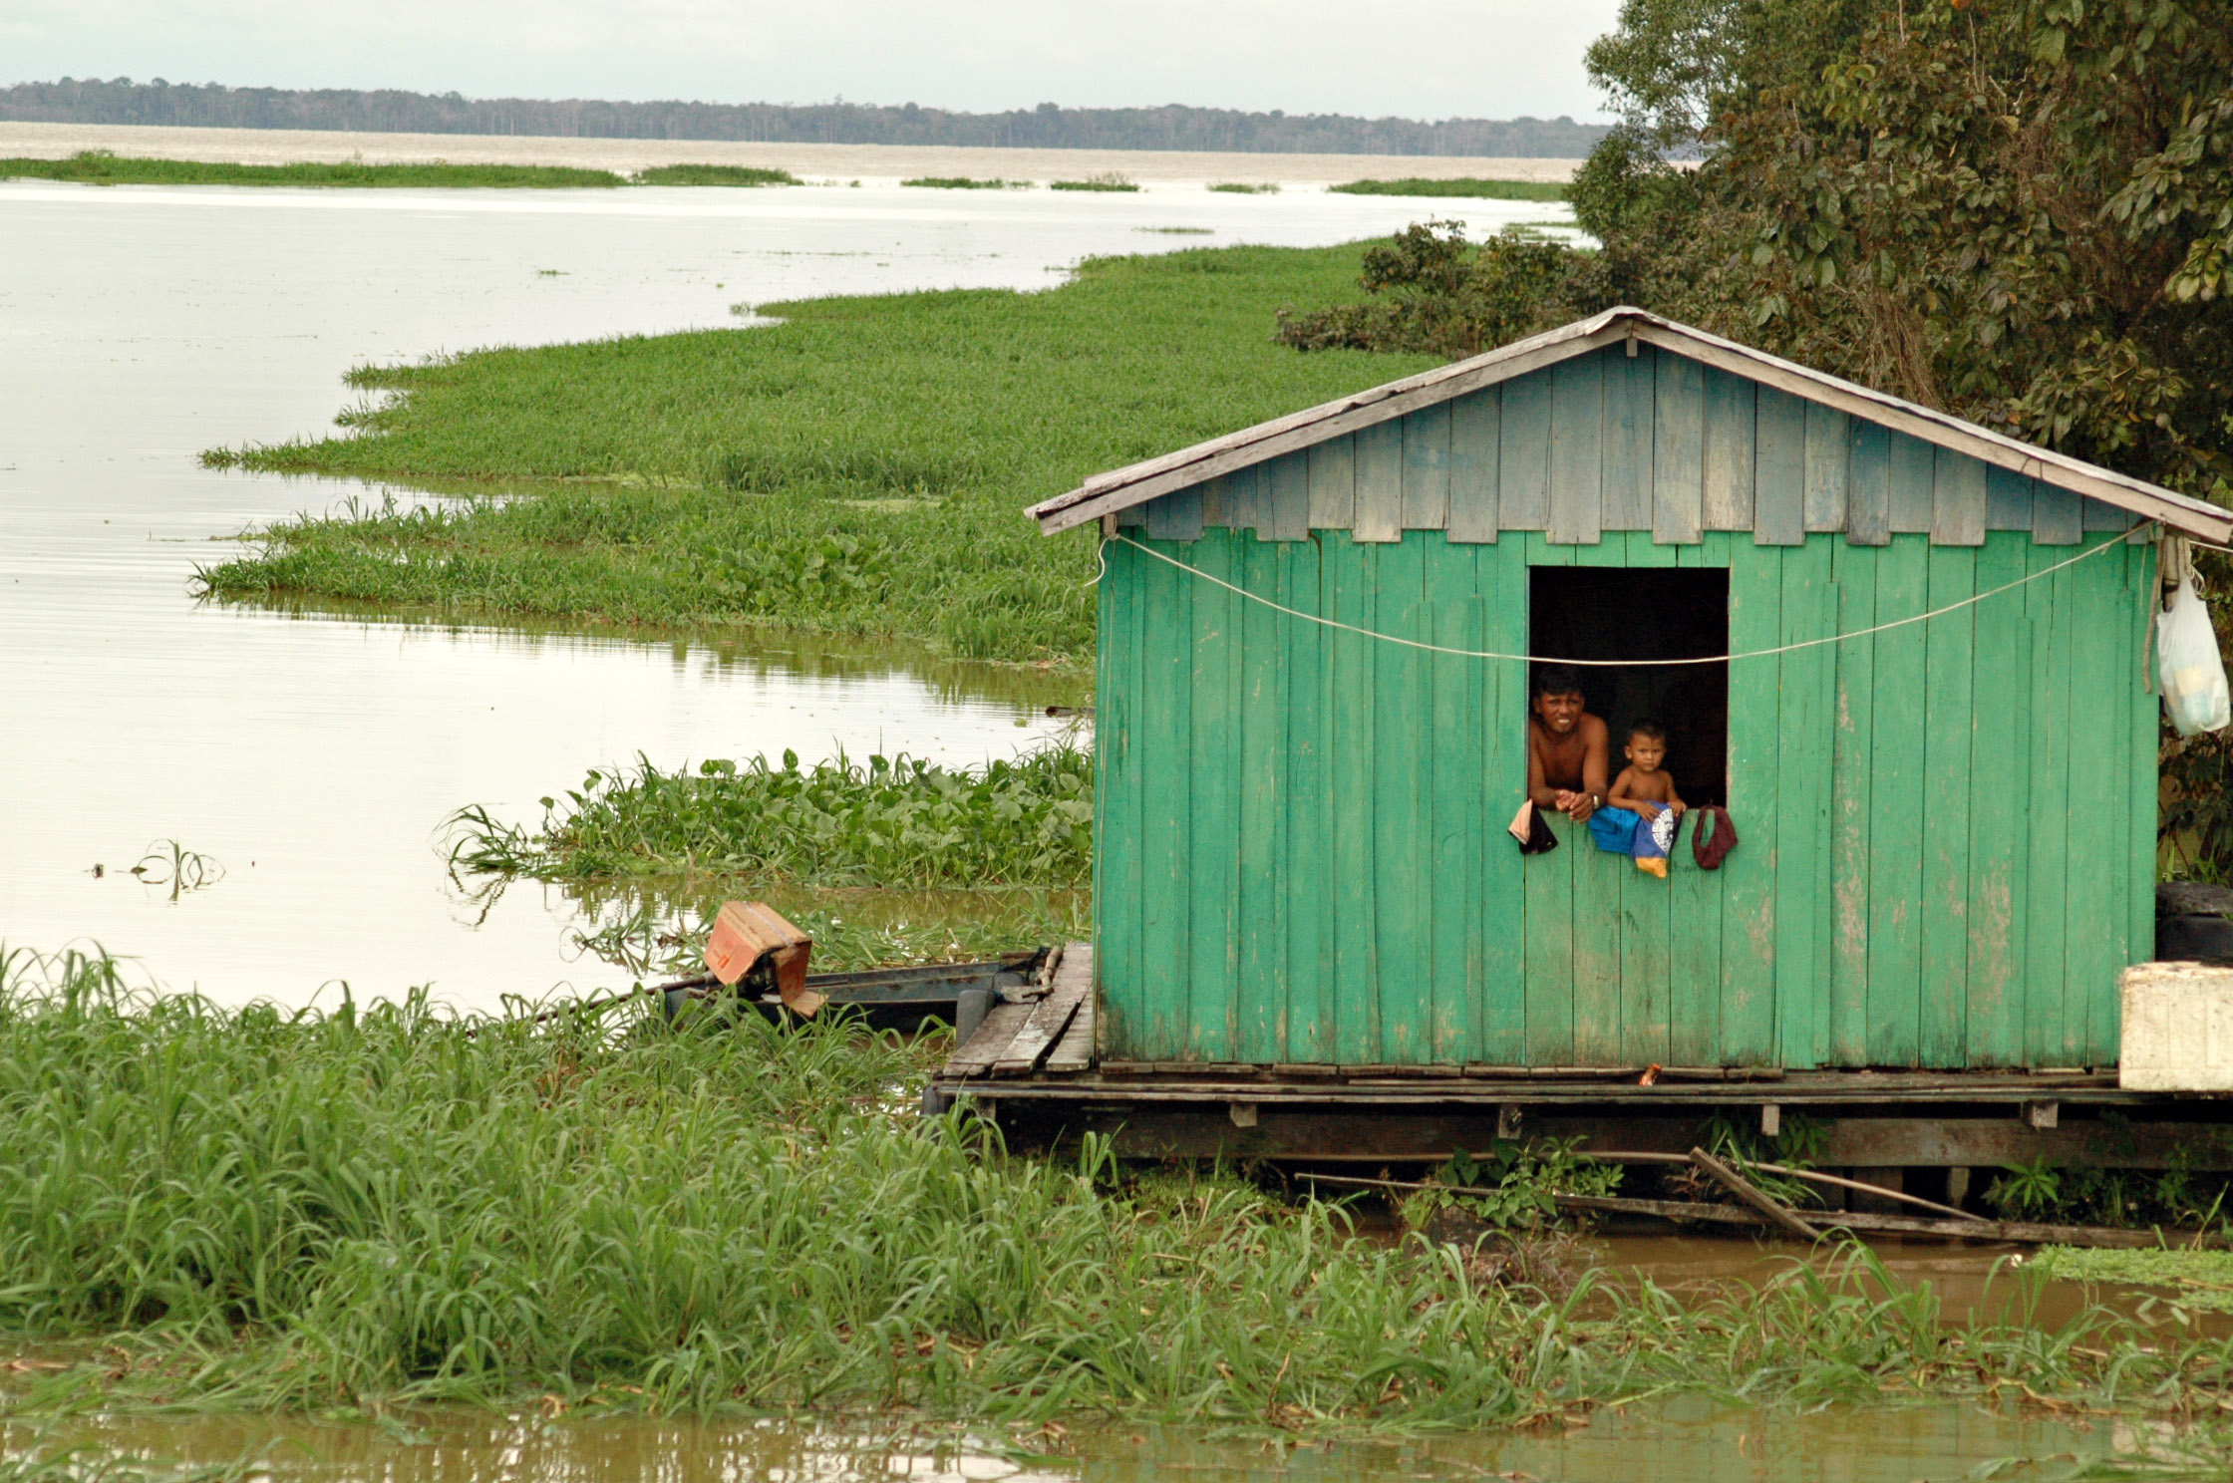
INFORMAL BALANCE

Slide 14

INFORMAL BALANCE

Slide 15
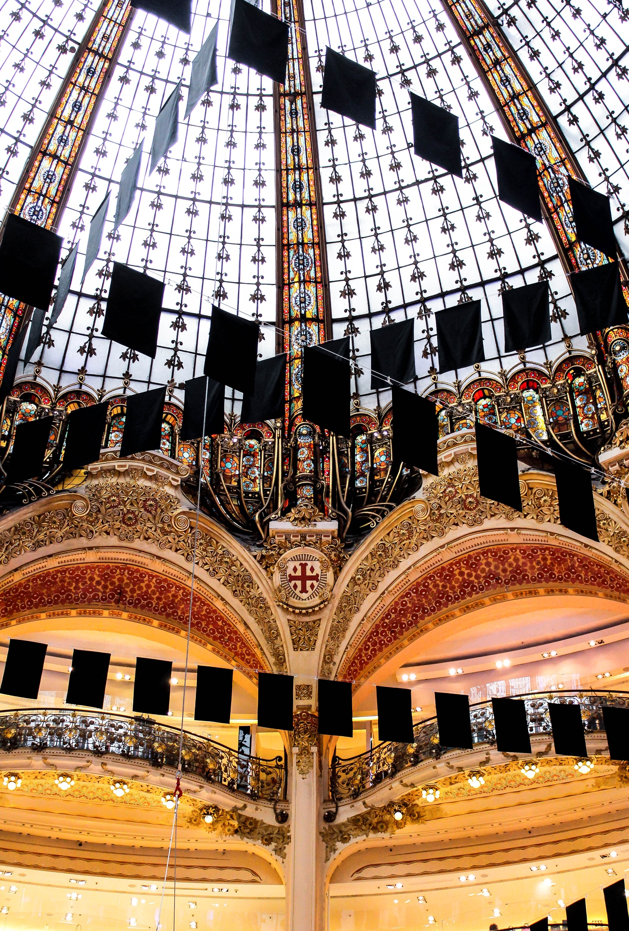
LEADING LINES
Our eyes naturally follow lines.
By strategically placing lines, you can draw the viewer’s eye around your photograph.
You want the viewer to jump to the focal point then have lines move the viewers eye around the rest of the composition.

Slide 16
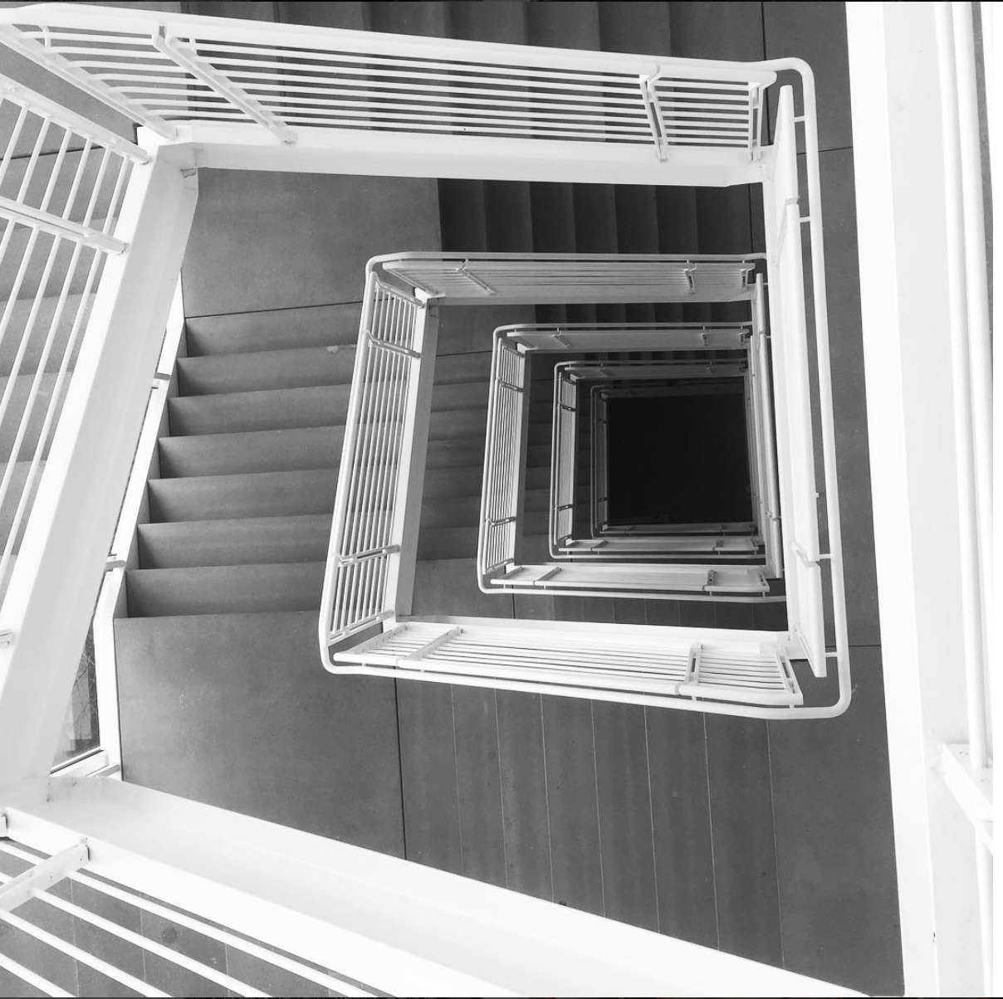

Slide 17
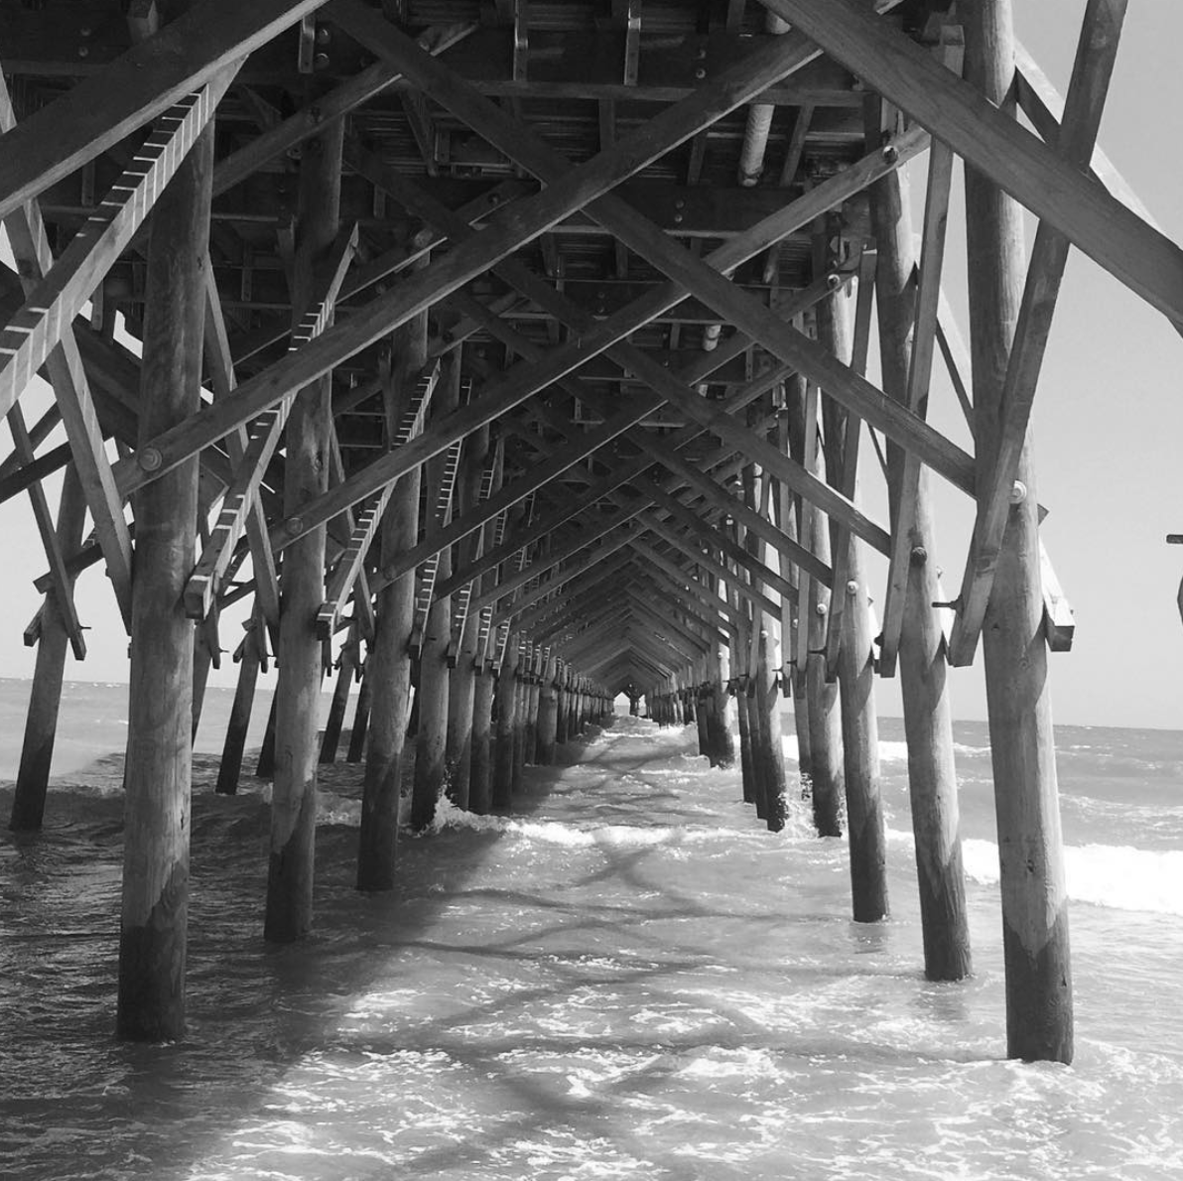

Slide 18
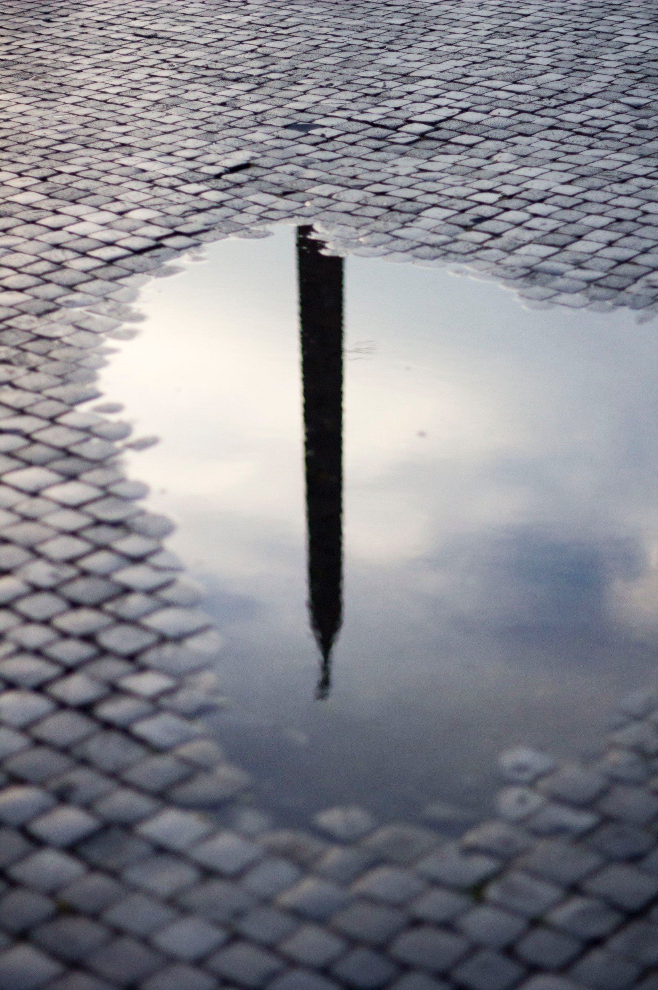
VIEWPOINT
Consider what the best position is to capture your subject.
Would it be more interesting to capture it from above?
What about getting low to the ground?
Will a straight on shot create more impact?
How do you want your photograph to come across?

Slide 19
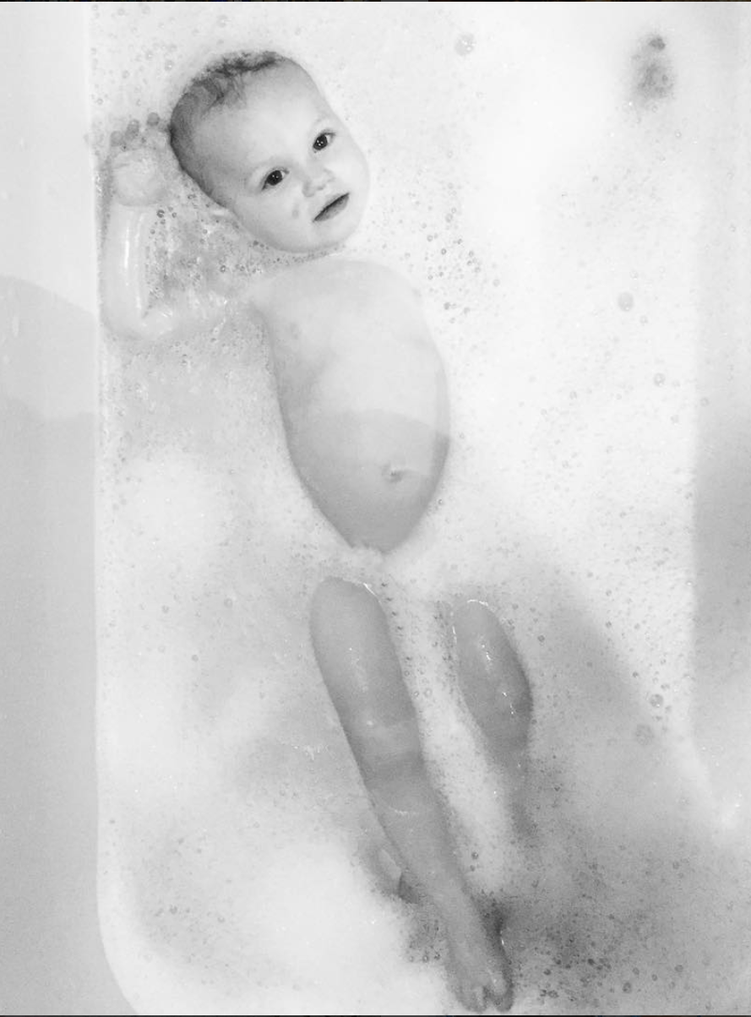
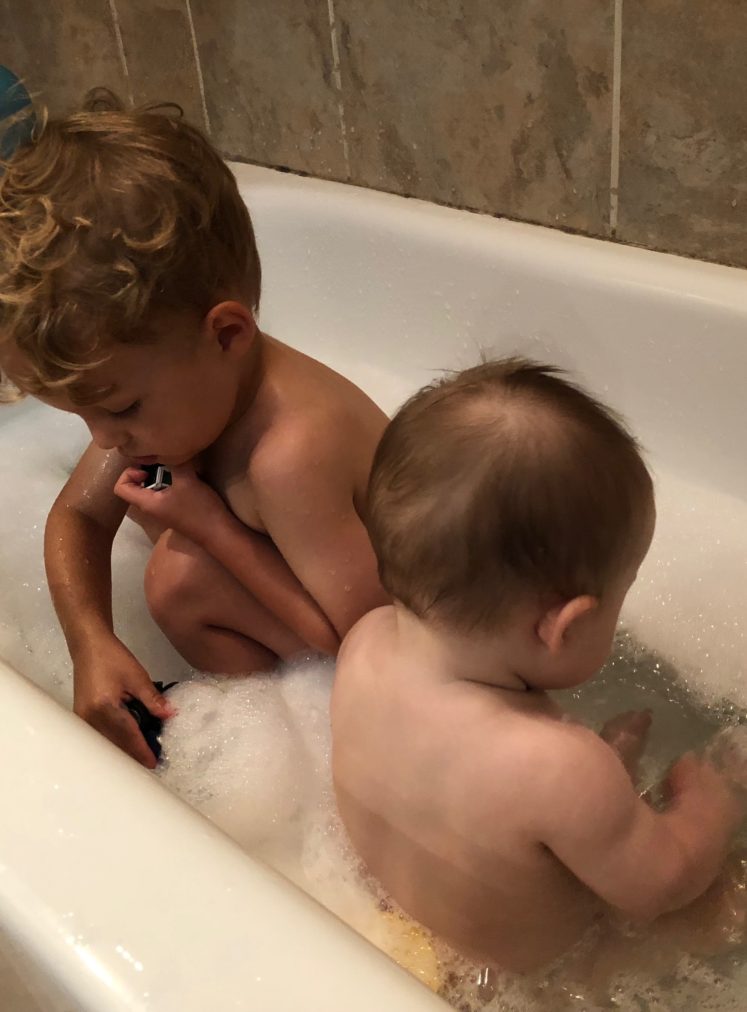
Side Shot vs. Overhead Shot:

Slide 20
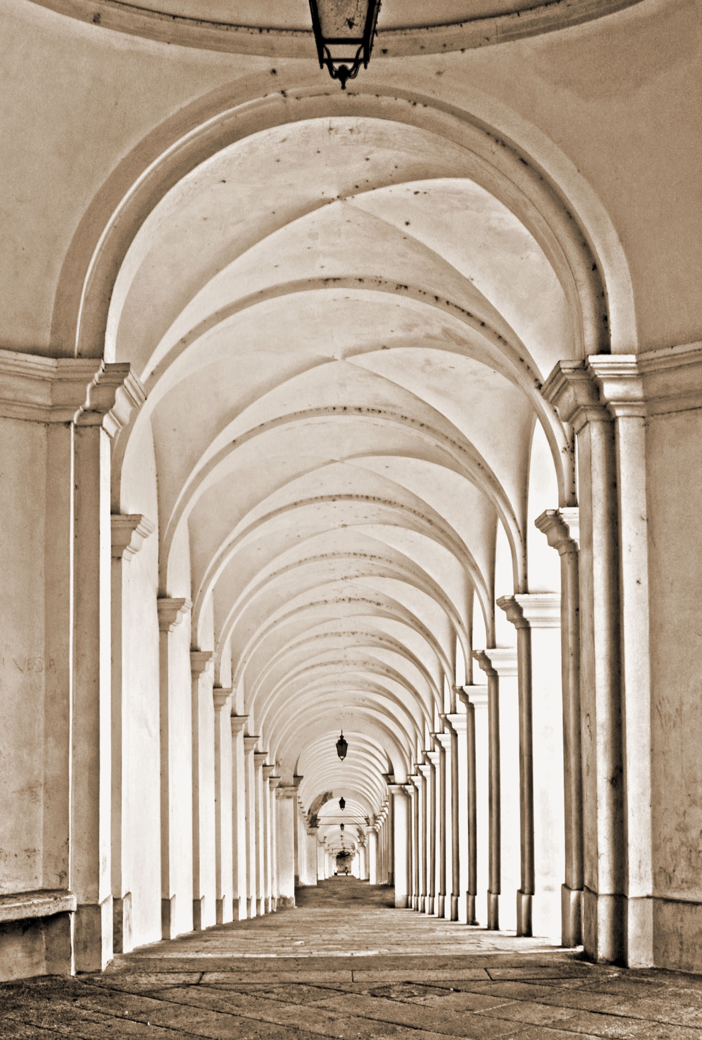
VIEWPOINT
A straight on shot is important in this instance.
Without a perfectly centered archway, you wouldn’t get the repetition and depth created by the arches going down the hall.

Slide 21
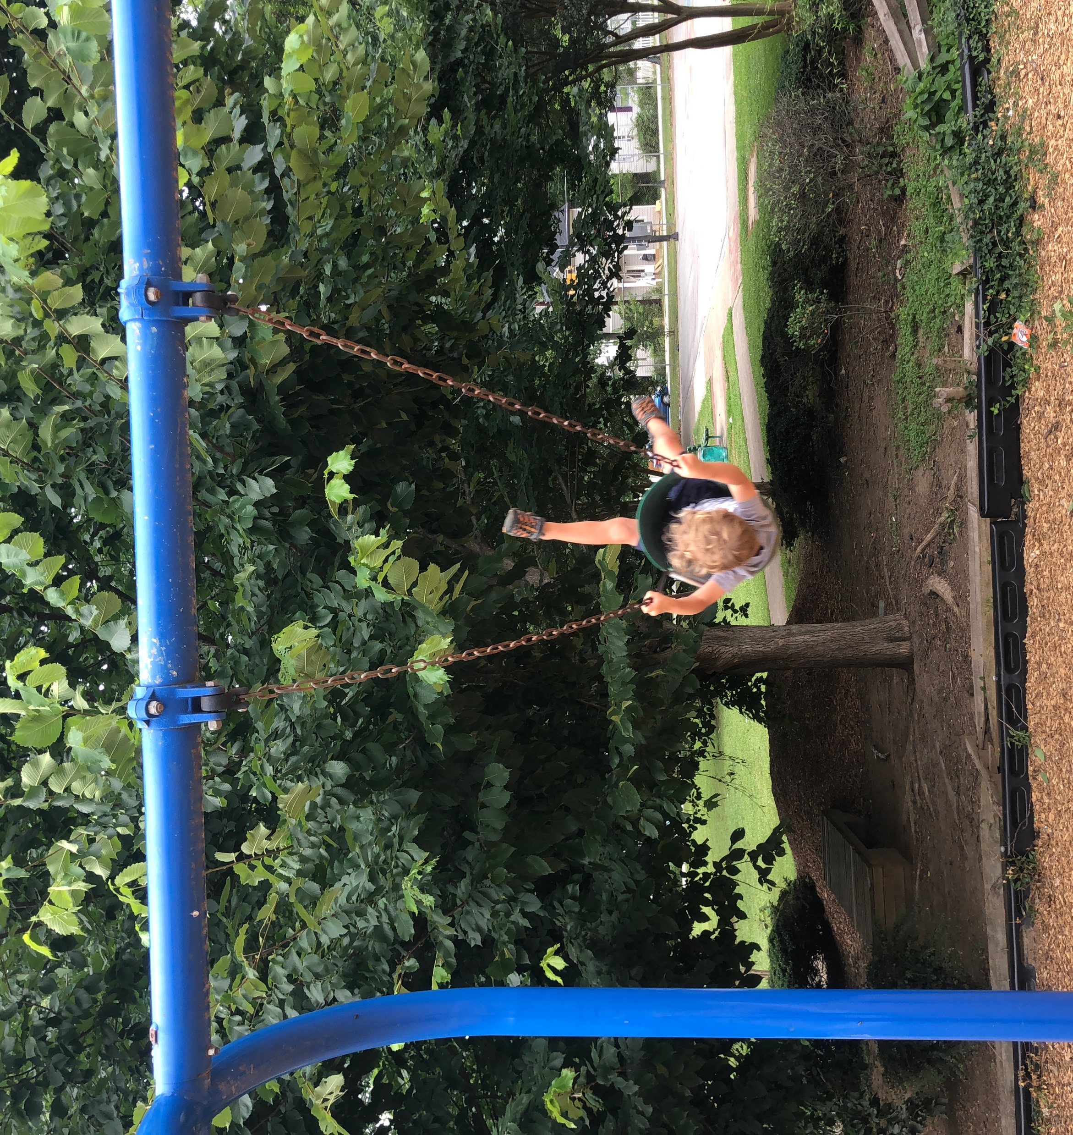
INCLUSION & EXCLUSION
What needs to be included to create a successful image?
Are there elements that would be better cropped out?
MERGERS are important to avoid.
MERGERS are background elements that compete with the subject.

Slide 22
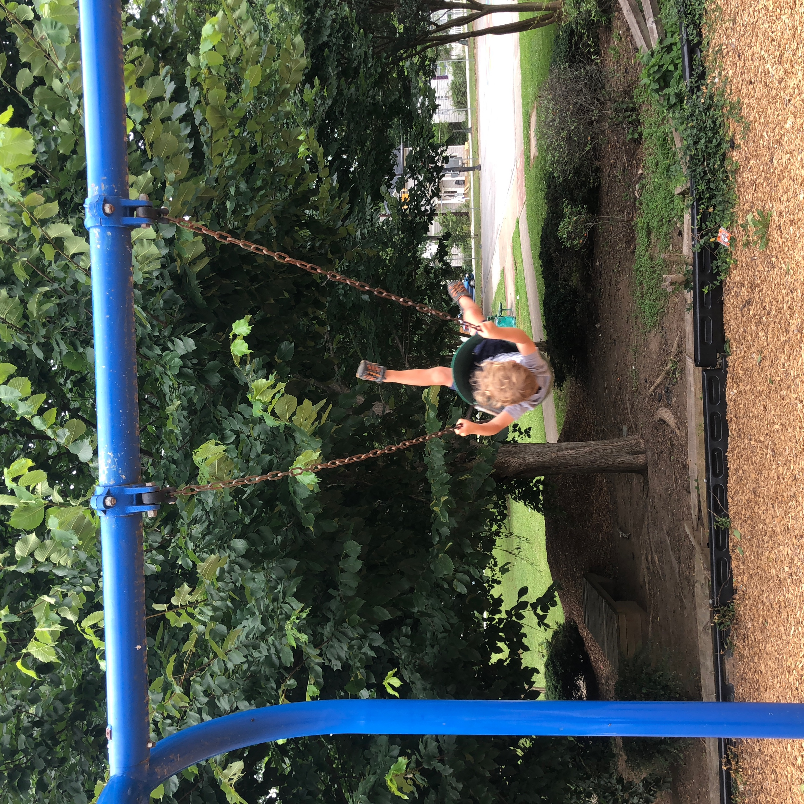
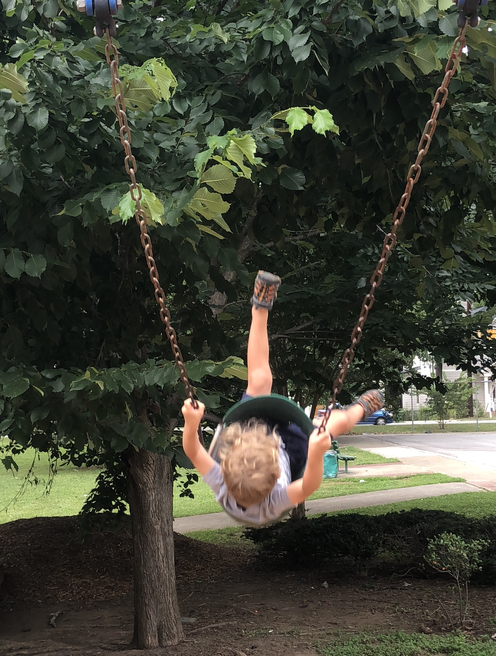
Uncropped vs. Cropped

Slide 23
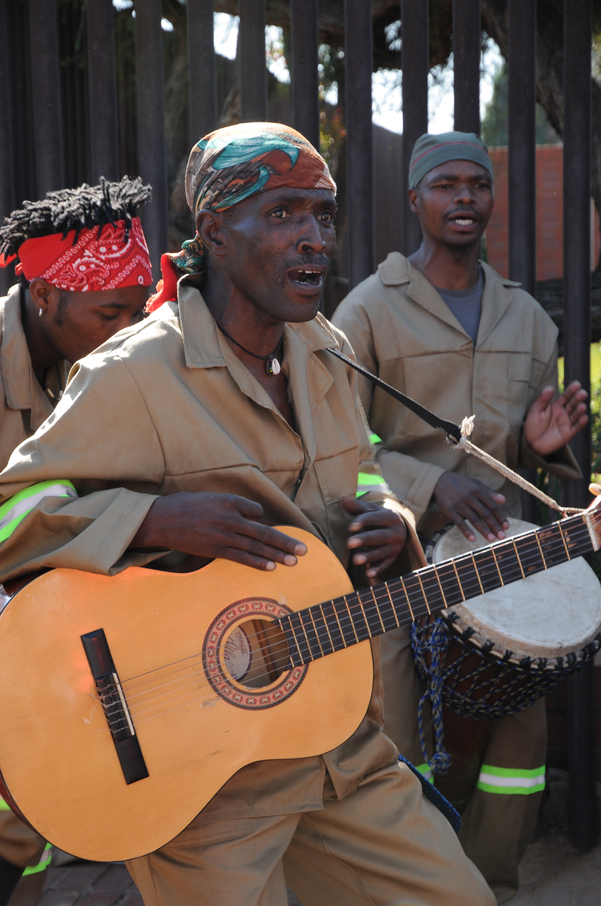
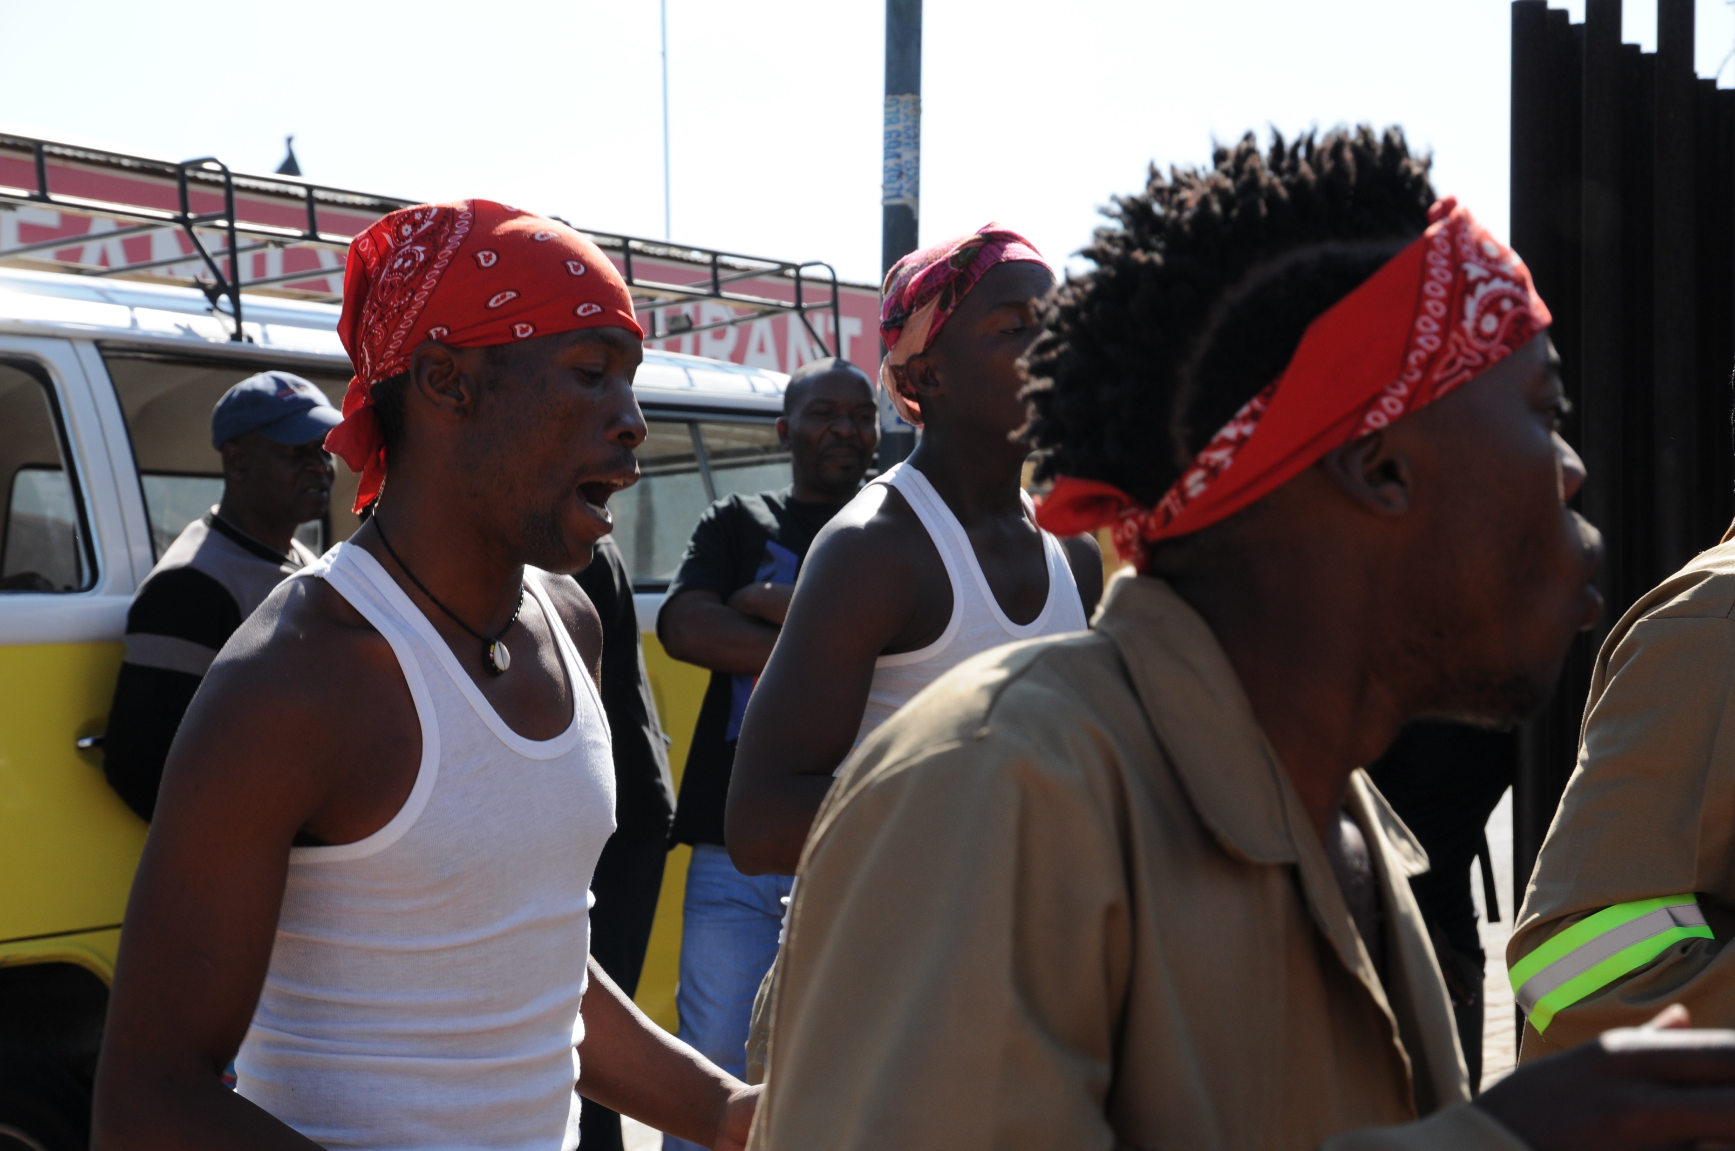
There were too many mergers in the first photograph, so the photographer changed viewpoints, excluded background people, and reshot the image.

Slide 24

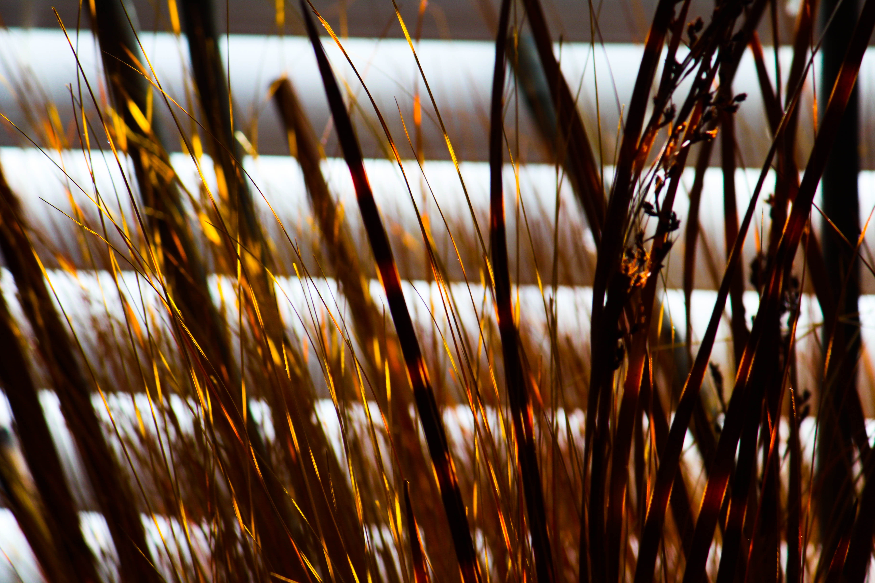
EXPERIMENTATION
Although there are “rules” in photography, all rules in art are meant to be bent and broken.
Don’t be afraid to try something new or that goes against the rules.
The beauty of digital photography is you can take hundreds of pictures and select the best one.

Slide 25
Your assignment…
Research artist, Ciro Totku, and see if you can identify the rules of composition used in his artwork.
Complete part 2 of the scavenger hunt, focusing on the rules of composition.
You will capture 7 photographs. The photographs need to be titled with the rule of composition it reflects and save them in a folder titled: Your Name/Rules of Composition.
You will get a participation grade for completing the artist research sheet and a partial project grade for completing the scavenger hunt.

Slide 26
THE END

